Slide 1
Current knowledge on the Green Deal
Comparative study
A survey of 14 questions was delegated to more than 100 students and academic citizens.
The random sample on which the research was conducted includes citizens in the territory of Sophia, Istanbul, Ankara, and Nis was used.
The results from this survey are compared with the answers from group divided to younger
than 25 years and older than 25 years

Slide 2
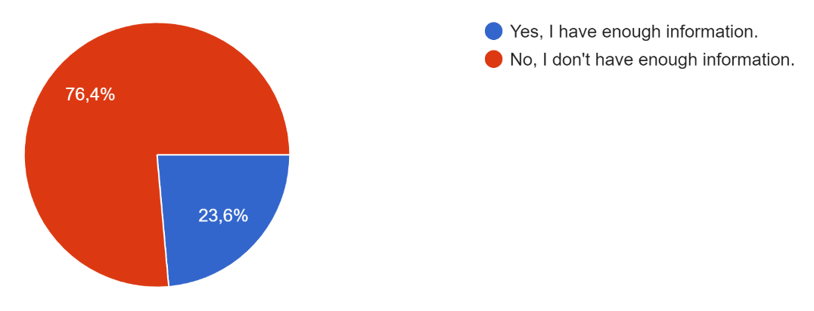
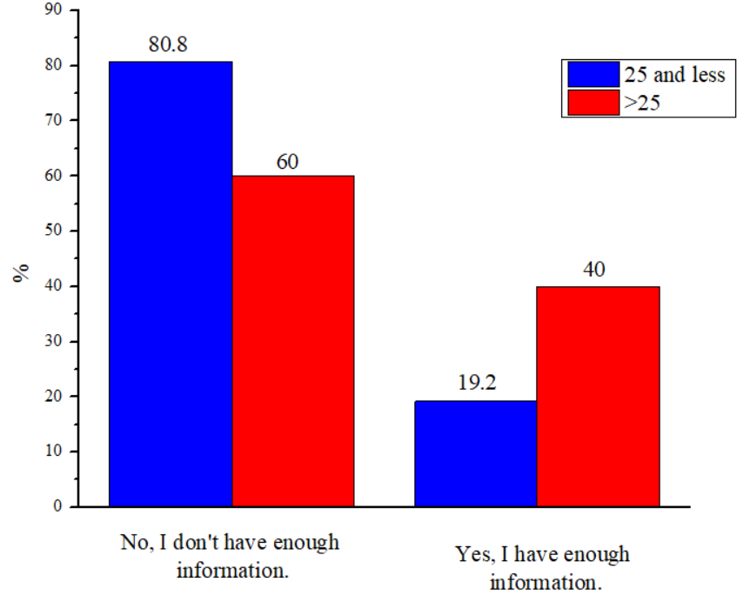
Distribution of answers to the question " Do you think you are knowledgeable about the European Green Deal?"
To the question "Do you think you are knowledgeable about the European Green Deal?",
most respondents answered no (67.4%). On the other hand, 23.6% of respondents point
out that their knowledge about European Green Deal is sufficient

Slide 3
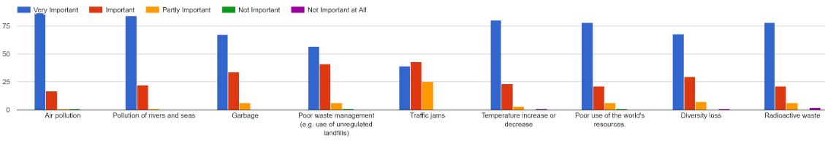
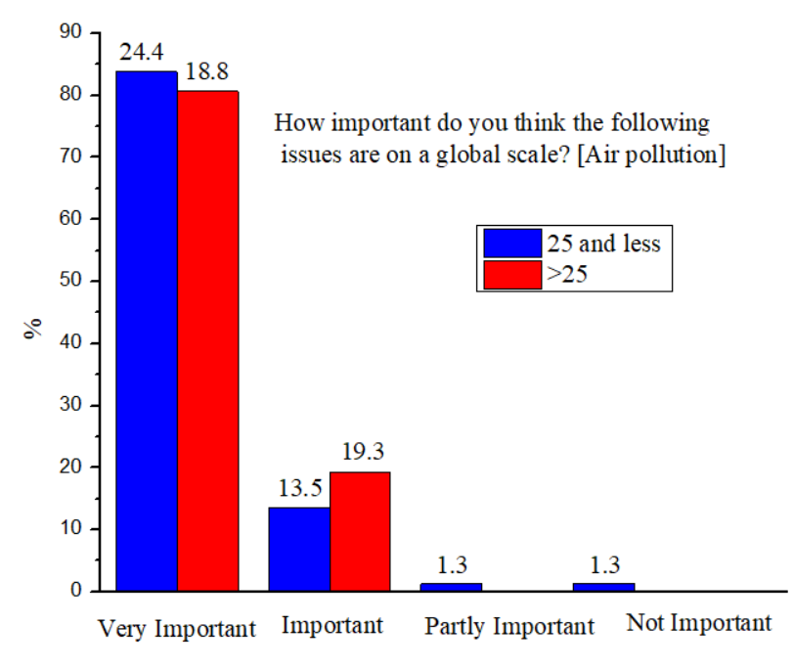
Distribution of answers to the question "How important do you think the following issues are on a global scale?”
To the next question, “How important do you think the following issues are on a global scale?
” more answers could be circled. The largest of the respondents (more than 75%) has market
that the very important issues are Air pollution, Pollution of rivers and seas, Temperature increase
or Decrease, Poor use of the world's resources, Diversity loss and Radioactive waste.

Slide 4
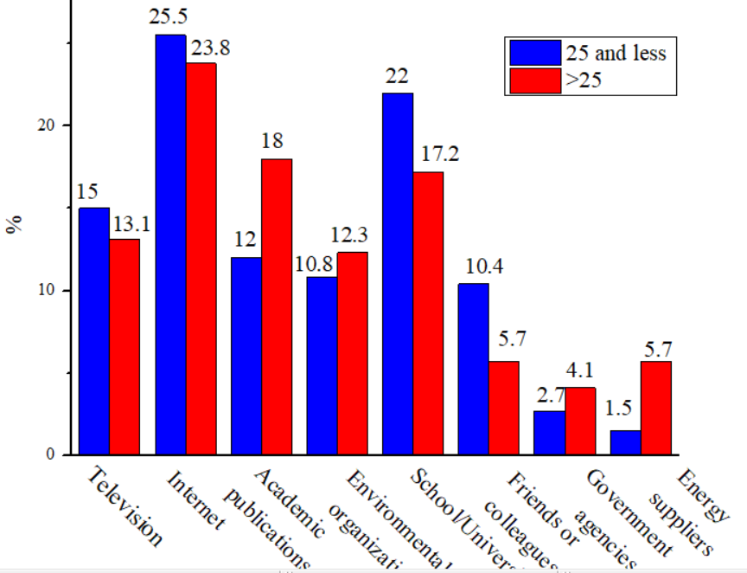
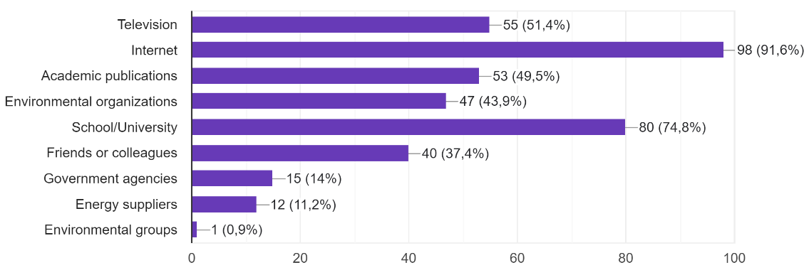
Distribution of answers to the question " In which of the following platforms have you heard about global climate change?”
This figures shows the platforms from which the participants get the most information about global climate change.
As expected, the most information about global climate changes examiners obtained both from internet (91.6%)
and school/University (74.8%).

Slide 5
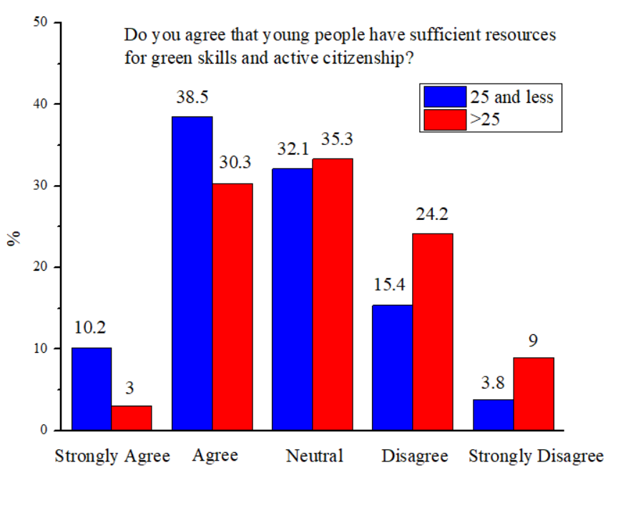
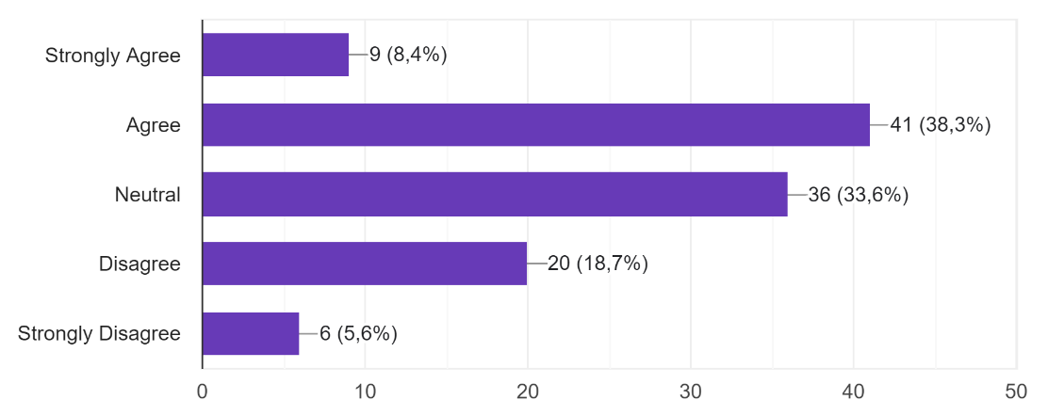
Distribution of answers to the question " Do you agree that young people have sufficient resources for green skills and active citizenship”
The next question deals with young people have resources for green skills and active citizenship air quality in the city itself.
On question “Do you agree that young people have sufficient resources for green skills and active citizenship?”
the answer agree and strongly agree was given by 46.7% examiners, 33.6 were neutral, while the answers disagree
and strongly disagree takes 24.3%

Slide 6
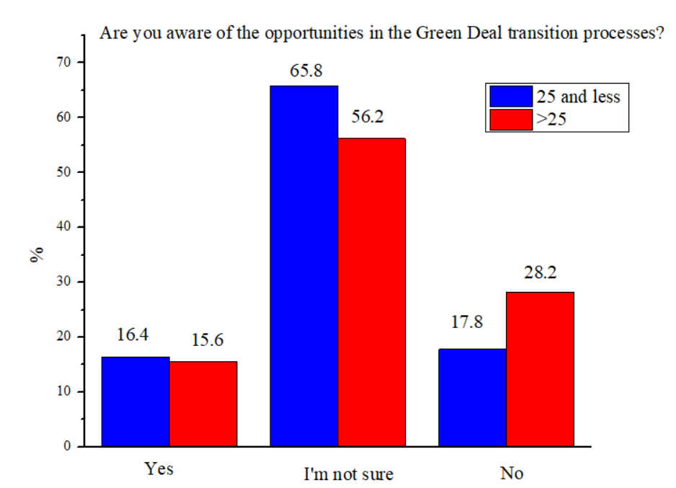
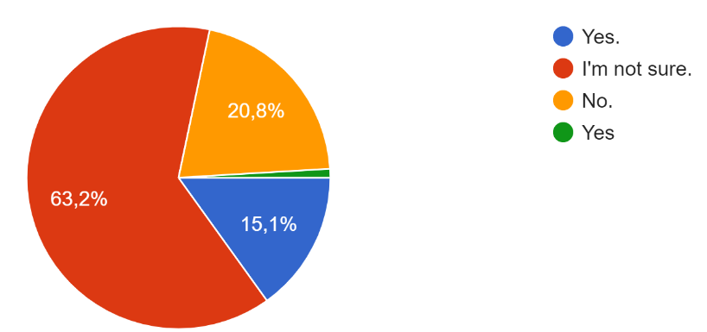
Distribution of answers to the question " Are you aware of the opportunities in the Green Deal transition processes?”
It was necessary to examine whether the respondents are aware of opportunities in the Green Deal transition processes.
The majority of respondents (62.3%) stated that they are not sure about the opportunities in the Green Deal transition processes,
20.8% do not have information, while only 16% of respondents are aware of opportunities in the Green Deal transition processes

Slide 7
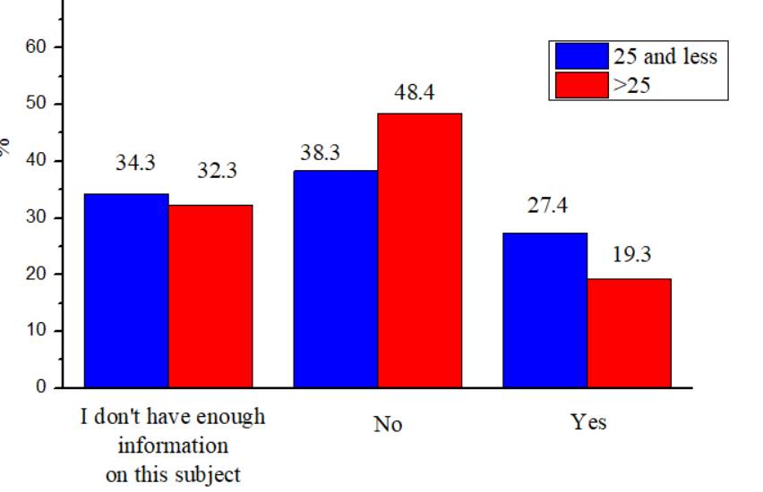
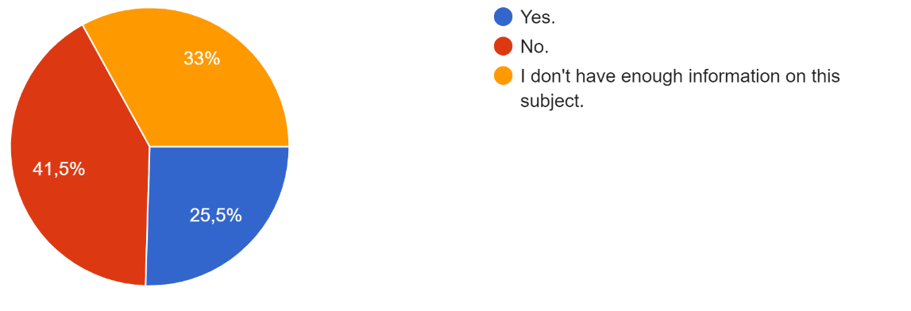
Distribution of answers to the question "Do you think that a sufficient number of activities for environmental management and sustainability
(resource efficiency, circular economy, waste recovery, etc.) are carried out to reduce environmental impacts?"
To the question “Do you think that a sufficient number of activities for environmental management and sustainability
(resource efficiency, circular economy, waste recovery, etc.) are carried out to reduce environmental impacts?",
the answer no was given by (41.5%) participants, while 25.5% gave a positive answer.
The rest of 33% answered that they don't have enough information on this subject.

Slide 8
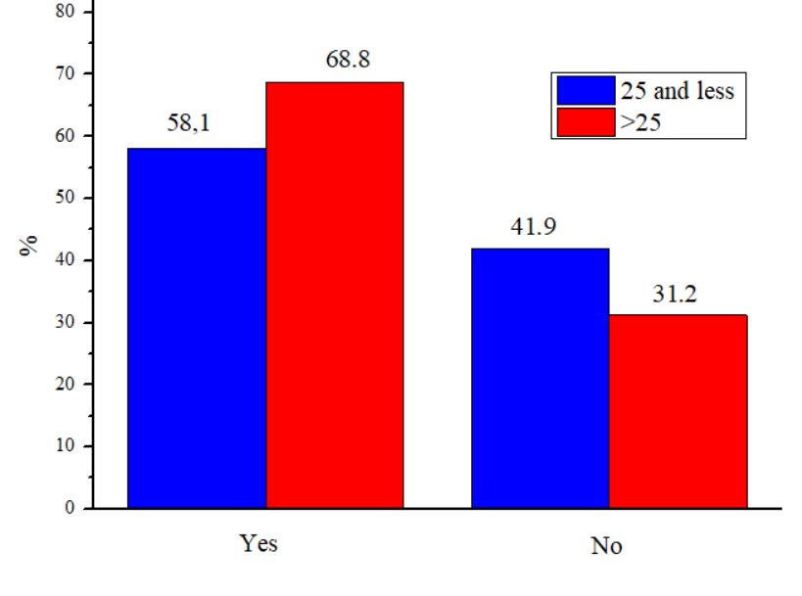
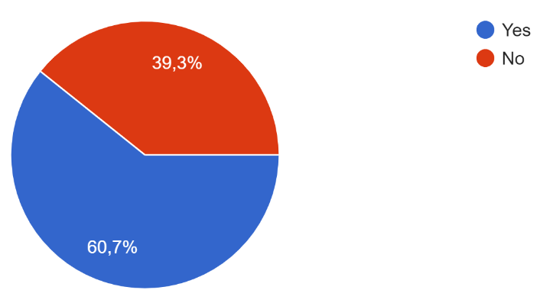
Are you aware of global policies or initiatives implemented by various organizations to reduce global warming / global climate change?"”
In next questions participants were asked the question "Are you aware of global policies or initiatives implemented
by various organizations to reduce global warming / global climate change?". According to participants opinion,
60.7% are aware while 39.3 do not aware of global policies or initiatives

Slide 9
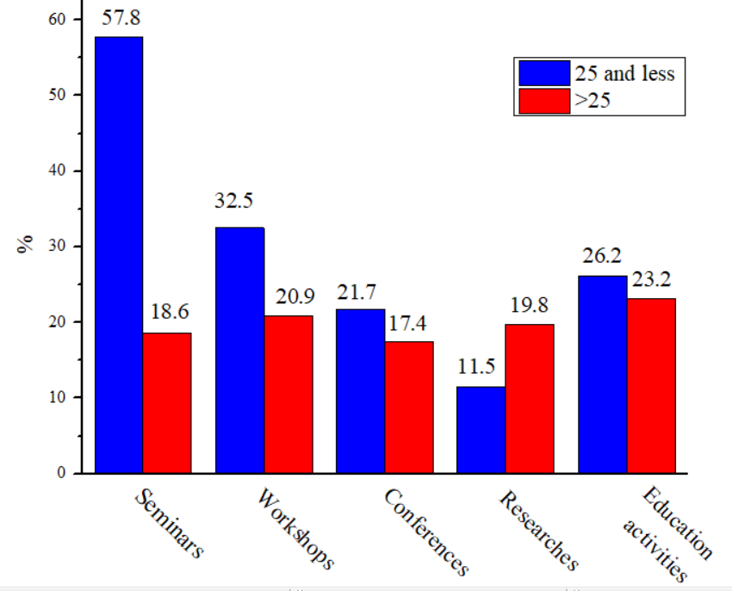
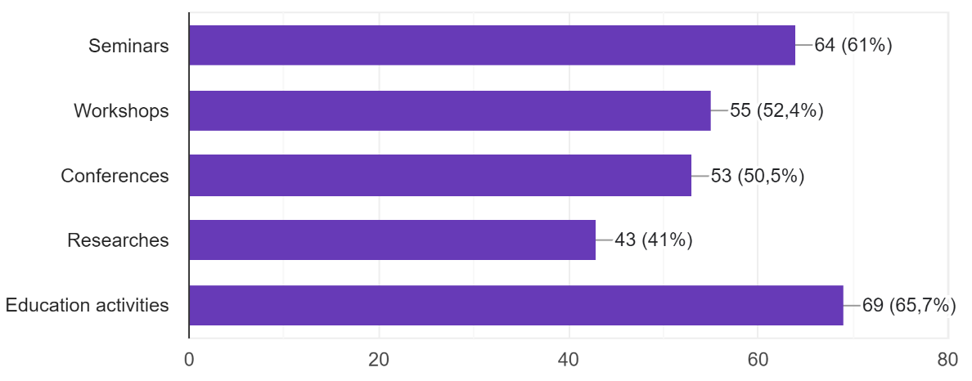
Distribution of answers to the question " What kind of activities would you like to participate in about EGD?"
One of the questions related to the education of citizens was “What kind of activities would you like to participate in about EGD”?
The participants gave the following answers: Seminars (61%), Workshops (52.4%), Conferences (50.5%), Research (41%),
Education activities (65.7%)

Slide 10
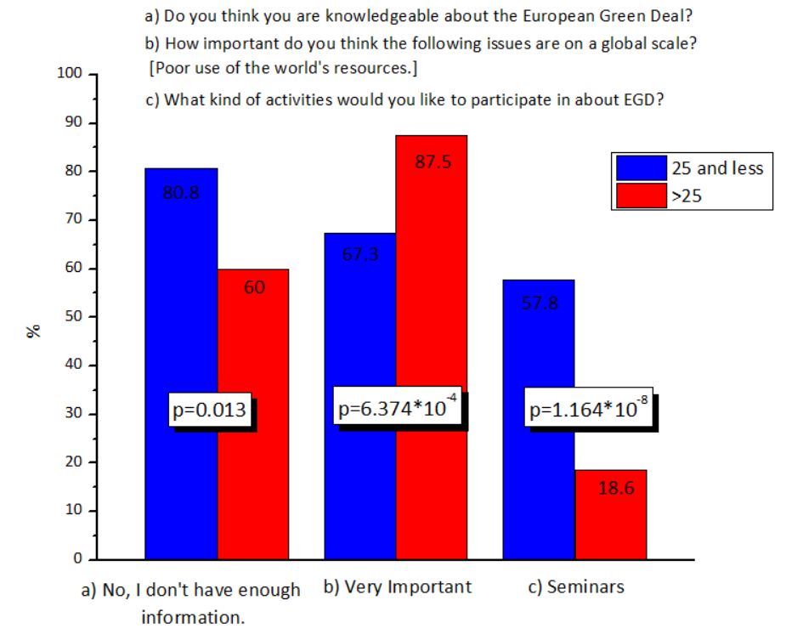
Finally the results with statistical significance in groups answers are present

