Slide 1



Non-formal teaching
Non-formal teaching techniques and strategies, best practices and case studies in Universities

Slide 2

Non-formal teaching techniques and studies
As part of informal ways of learning, such studies, which are usually carried out in natural environments, outside of classrooms, laboratories and other closed spaces, have been assumed to be very effective.

Slide 3

Field learning as an informal educational method
Field learning is one of the methods of outdoor education which is conducted outside the classroom. Field learning forms part of the curriculum of subjects in a wide range of sciences including biology, geomorphology, geology, archaeology, social sciences, implementing practical exercises, student’s practical work, etc.
Field study corresponds to activities that take place in botanical gardens and zoos, historic sites and museums, national parks, wetlands, wild-nature areas, etc. It offers the opportunity to acquire the most valuable experiences of students through images captured personally, by their senses

Slide 4

Field learning advances
Students have the opportunity to observe and collect data from the field and exchange their views with members of ecological organizations, representatives of local authorities, as well as residents, thereby determining differences in understanding some problems.

Slide 5

Phases in the field study
1.
2.
3.
Field study requires systematic and careful preparation by the instructor or teacher. Te instructor must take care that the study is well defined, that the students' activities are clear and well planned in advance, and that the outcome is well prepared.

Slide 6

The first phase
Preparation - involves the preliminary action of preparing or finding relevant literature and locating subjects suitable for field study, studies of the places or areas of observation or exploration, and organizing a preliminary visit to the field area in order to familiarize students with the study object.

Slide 7
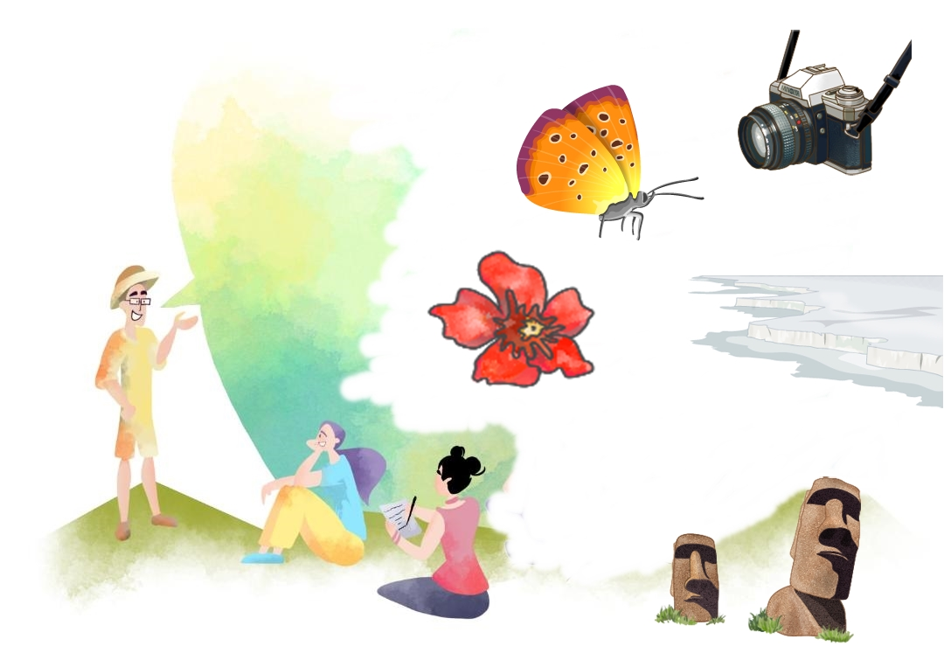
The second phase
Fieldwork itself - in the field, students, either in groups or alone, are assigned certain activities. Activities may vary and their nature depends on their goals and abilities, as well as opportunities. Field activities may include observation and comparison, mapping, sampling, taking images, collecting some important objects, stones or plants to document, etc.

Slide 8

The third phase
Analysis and presentation of the results - after the completed fieldwork, the processing of the collected data follows, which leads to the analysis and interpretation of the collected data. During this phase, students can prepare a report containing the main points of their research. Communication between students is considered important at this stage.

Slide 9

Instead of conclusion
Meet natural values to better preserve biodiversity for the future of humanity and nature itself

