Slide 1



Non-formal teaching techniques and strategies, best practices, case studies
Field study in biodiversity and endangered species conservation

Slide 2

Field study in biodiversity and endangered species conservation
Participants in such a study are introduced to the context of biodiversity and species conservation meaning. Pparticipants focus on collecting relevant field data and the instructor facilitates them to contact with appropriate sources.

Slide 3
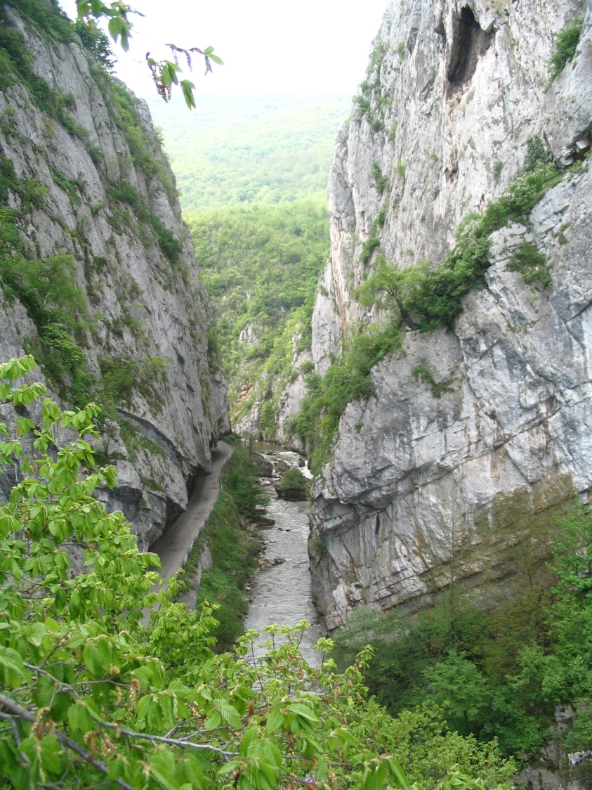
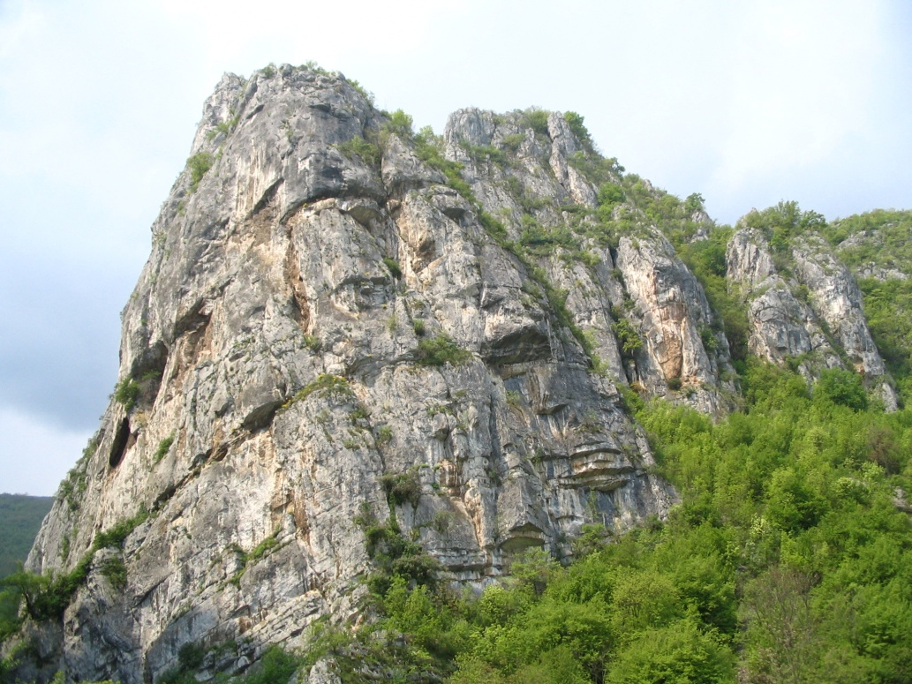
Field learning in the Special Nature Reserve "Jerma“, Serbia
Participants in the field study conducted their fieldwork in the rich natural environment of the Jerma Gorge. This beautiful, border area is an internationally important and protected area in Serbia.

Slide 4
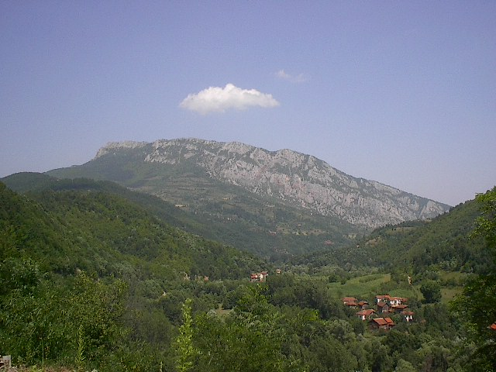
A few general facts about the protected area at the beginning....
Special Nature Reserve "Jerma" belongs to category Ι – Protected area of international abd national importance. This protected natural area is located in southeastern Serbia and includes the massifs of Greben and Vlaška mountains, as well as a major part of the Jerma river basin.

Slide 5
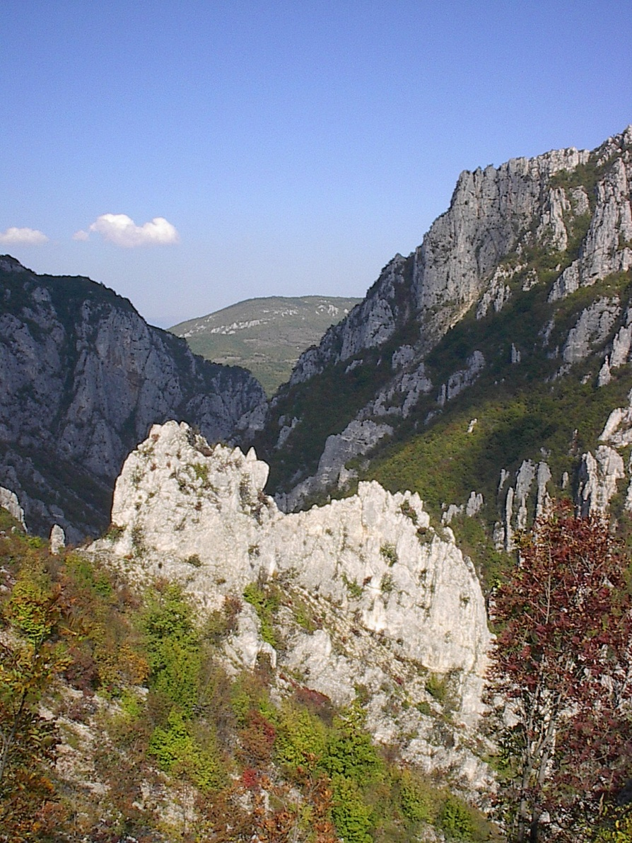
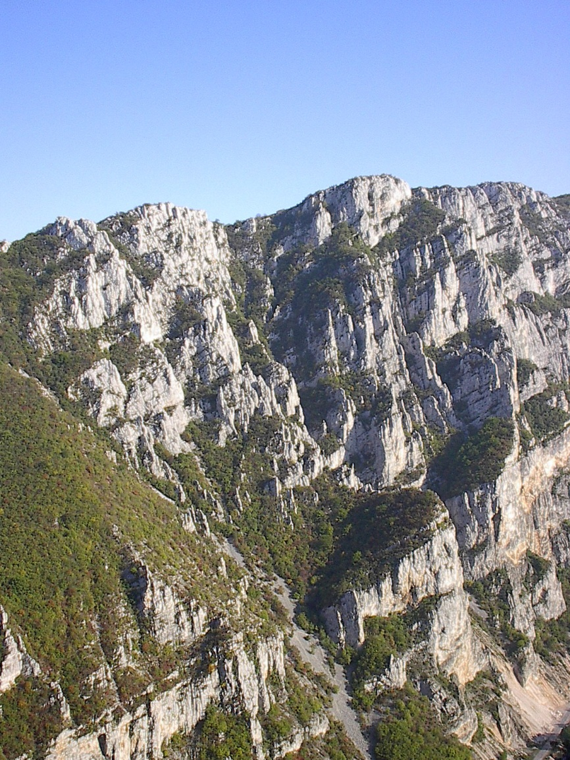
We met the geodiversity
The Special Nature Reserve "Jerma" is a unique complex of valleys and limestone gorges with imposing cliffs over 700 m high, numerous caves, pits, sinkholes and rock figures.

Slide 6
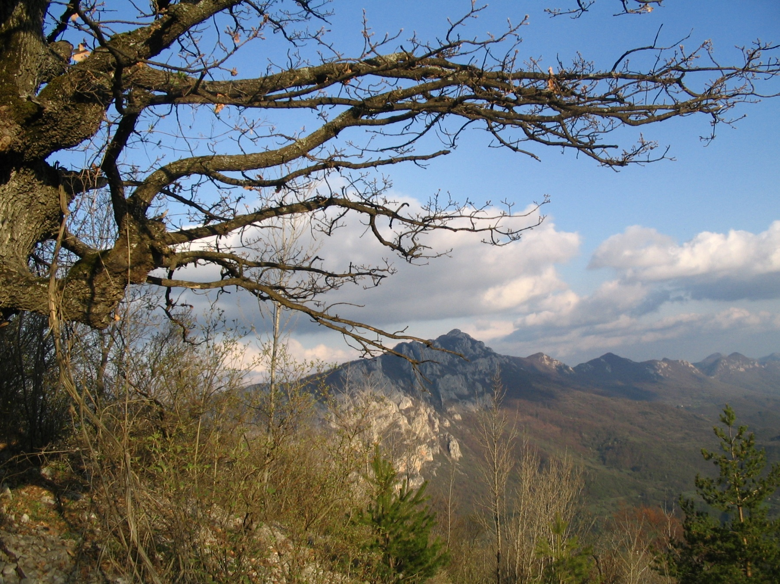
The limestone ridge of Greben Mountain

Slide 7
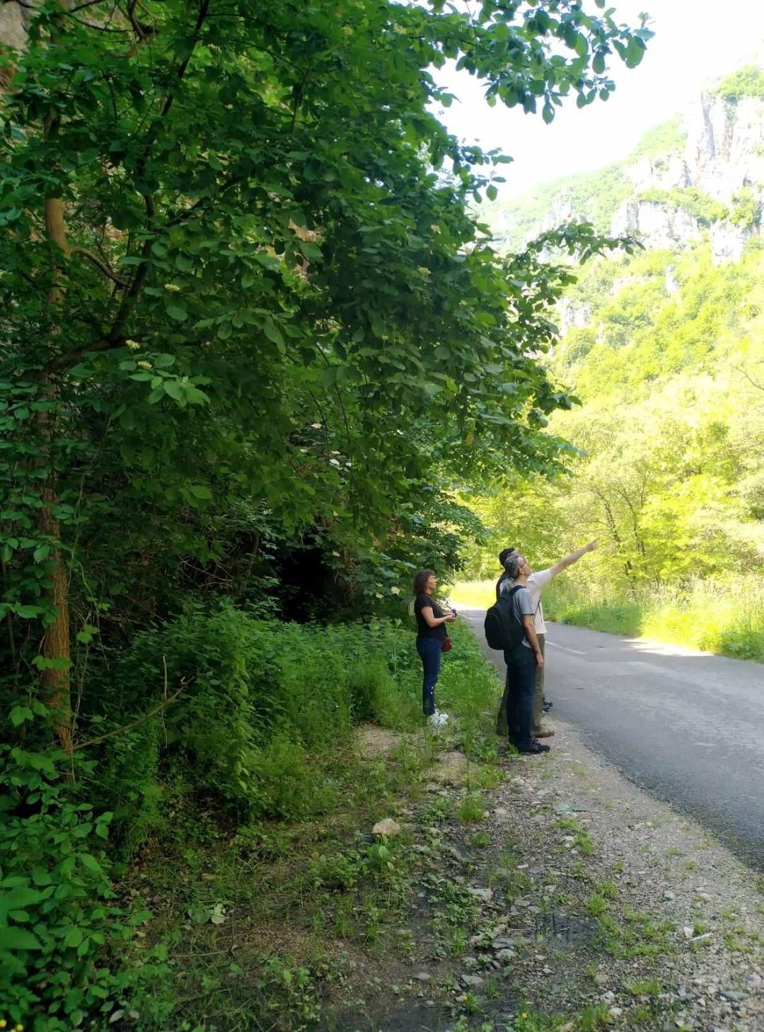
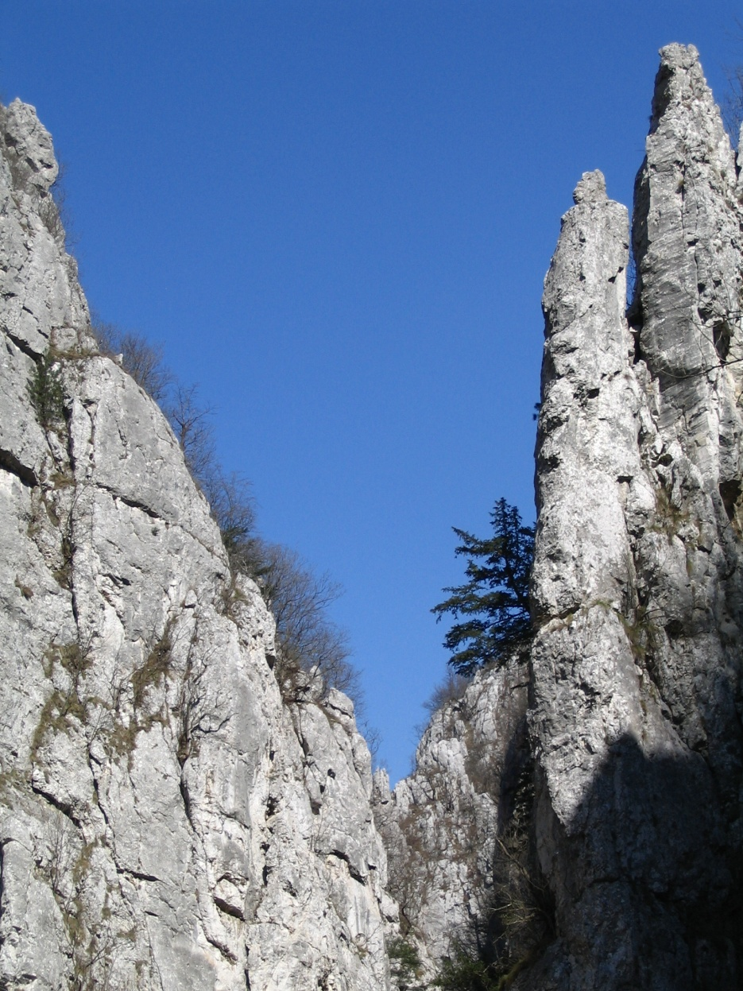
Getting to know the fundamentals of biodiversity
Explanation of
biodiversity facts
Specimens of Taxus baccata (yew) on
shatered, limestone cliffs
The reserve is characterised by exceptional diversity, ecosystems and a large number of rare and endangered species. Among 110 bird, 25 mammal, 11 amphibian and reptile, 9 fish, 181 butterflie and 901 plant species, some of which can be observed during thefield work.

Slide 8
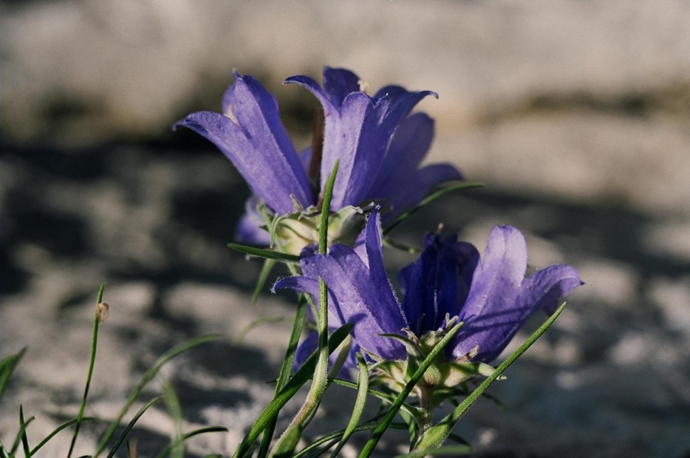
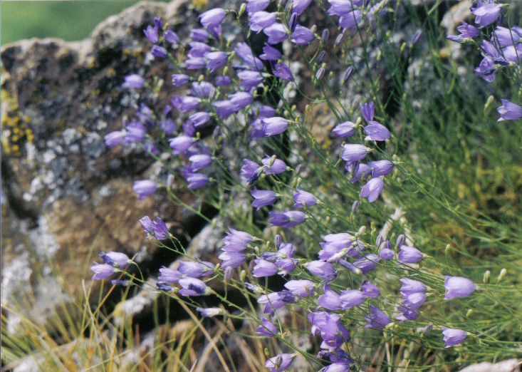
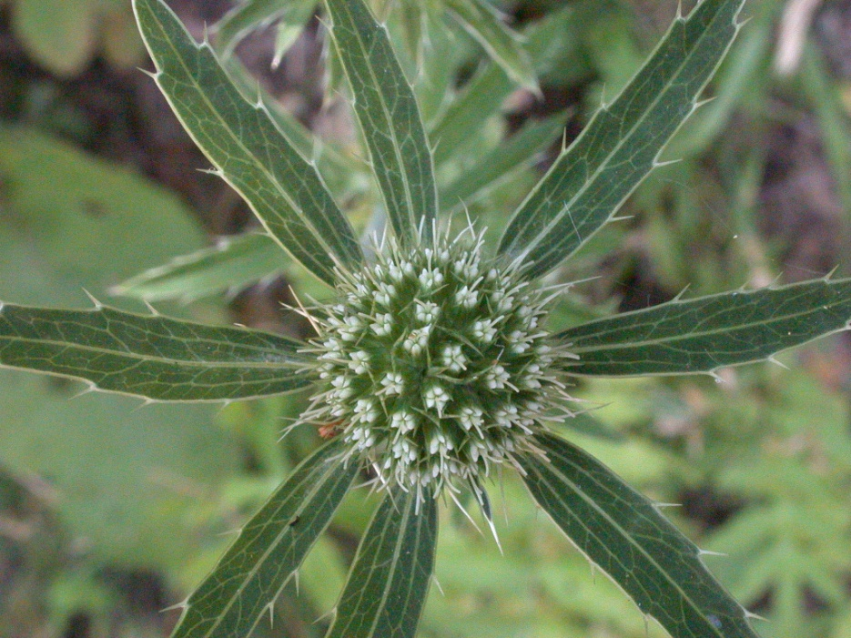
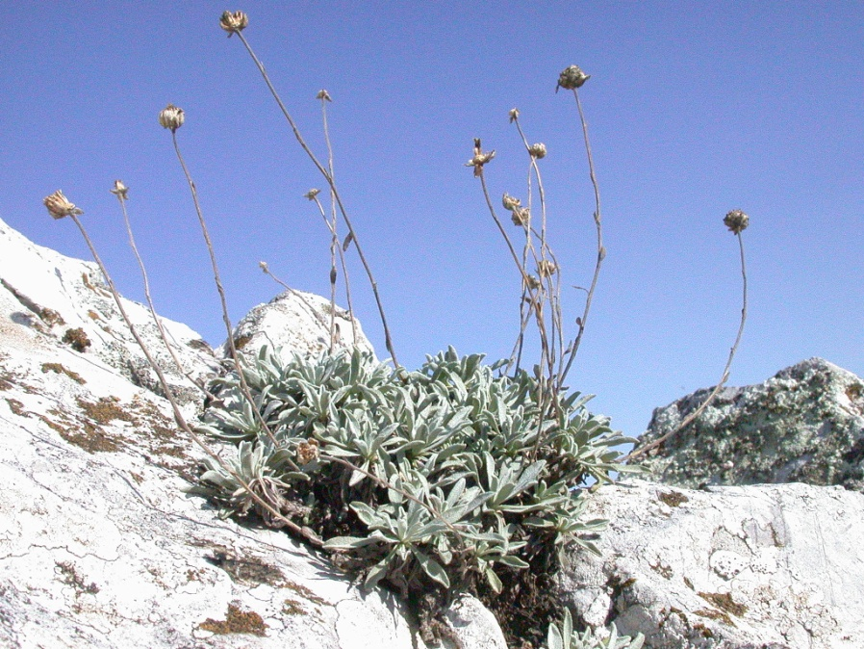
Observing endemic and rare plant species
Edraianthus serbicus (Grassy Bells)
Campanula velebitica (Bell Flower)
Eryngium palmatum (Sea Holly)
Achillea serbica (Yarrow)
This reserve is an area of exceptional floristic diversity, ecosystems and a large number of rare and endangered species. Of the 901 plant species recorded so far the most important which will be observed in the field.

Slide 9
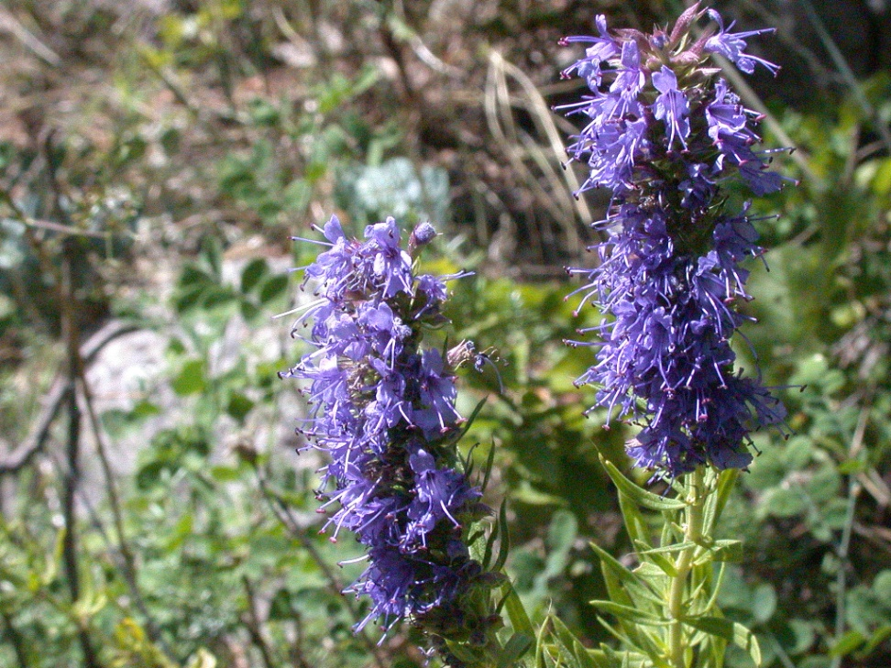
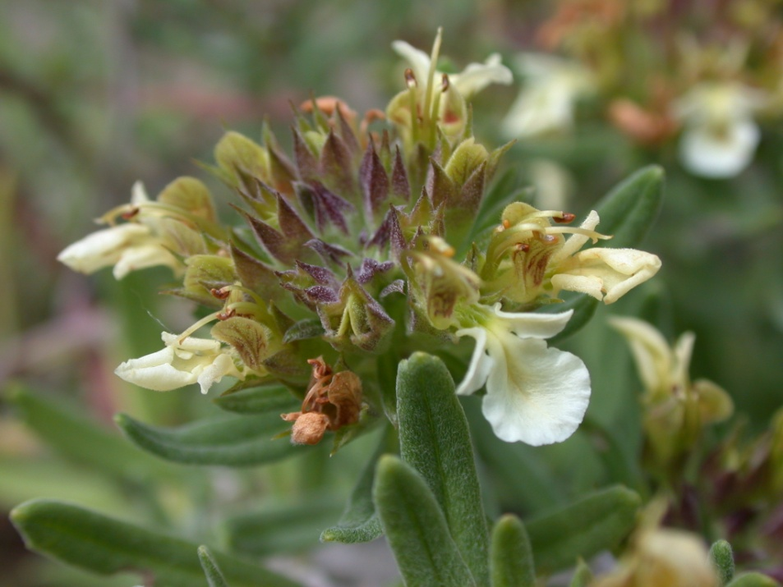
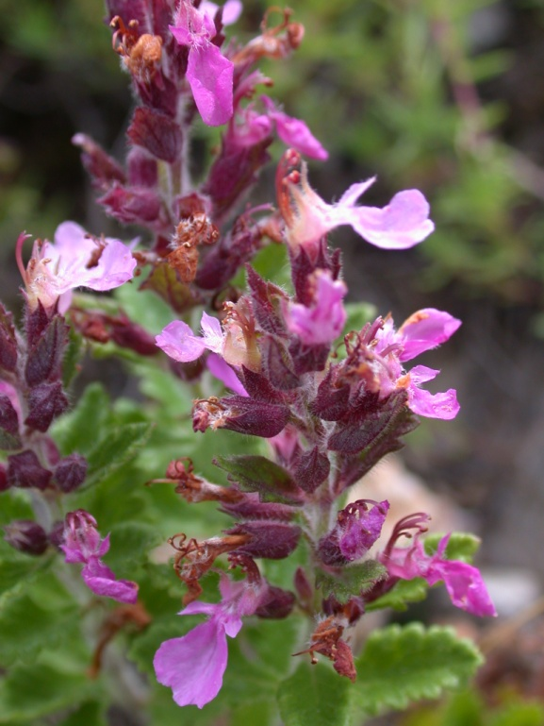
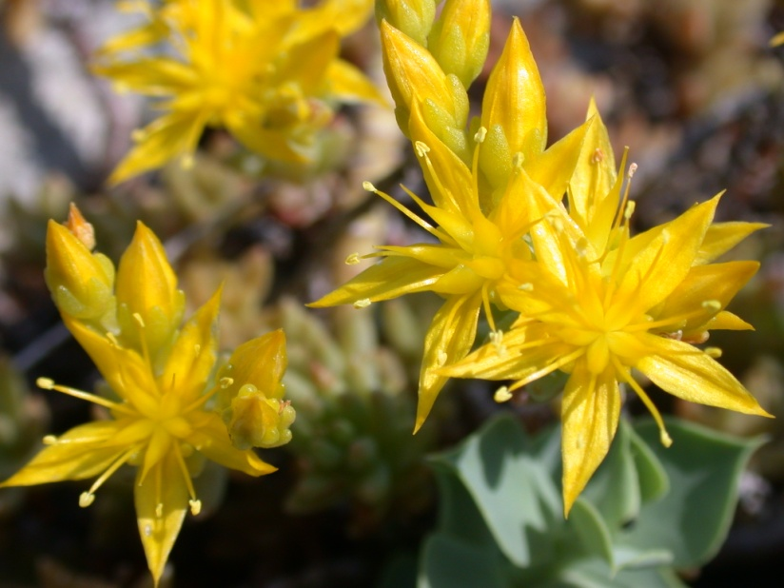
Observing medicinal and other important plant species
Hyssopus officinale (Hyssop)
Teucrium montanum (Mountain Germander)
Sedum acre (Goldmoss Stonecrop)
Tucrium chamaedrys (Wall Germander)
The presence of well-preserved populations of medicinal, wild-growing edible and other important plants is of great meaning for sustainable development.

Slide 10
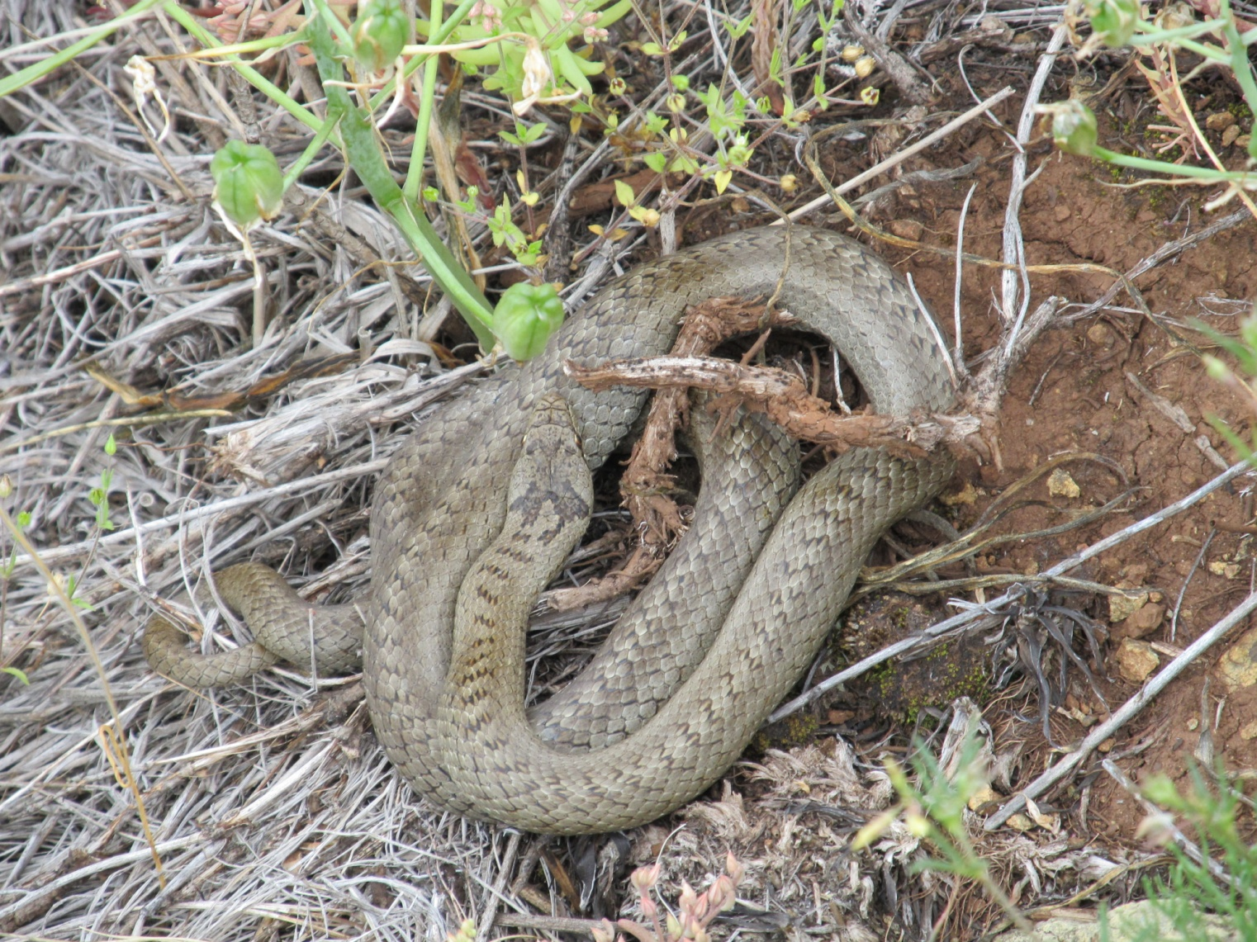
The smooth snake (Coronella austriaca) is a non-venomous snake from the Colubridae family that also could be found in this gorge.

Slide 11
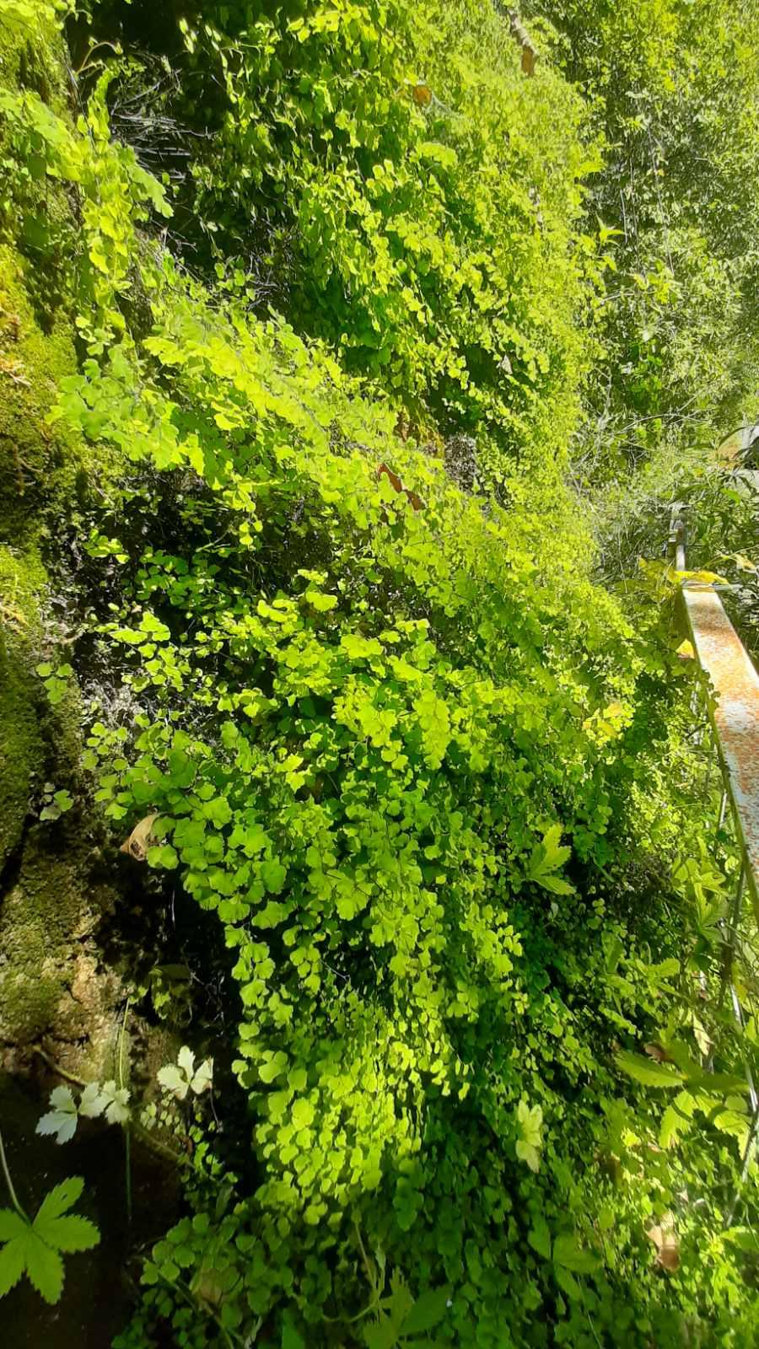
Endangered fern: The case of extinction and species conservation
Venus Hair Fern is a small fern that grows near the hot springs in the reserve. This is its only habitat in Serbia, while the species is critically endangered according to the IUCN.
After capturing the source, the habitat changed and the species almost disappeared. The plant was saved by the quick reaction of the local community and the Institute for Nature Protection.
By visiting this locality, we welcome good examples of preserving the species and their habitats in nature.
Venus Hair Fern (Adiantum capillus-veneris)

Slide 12
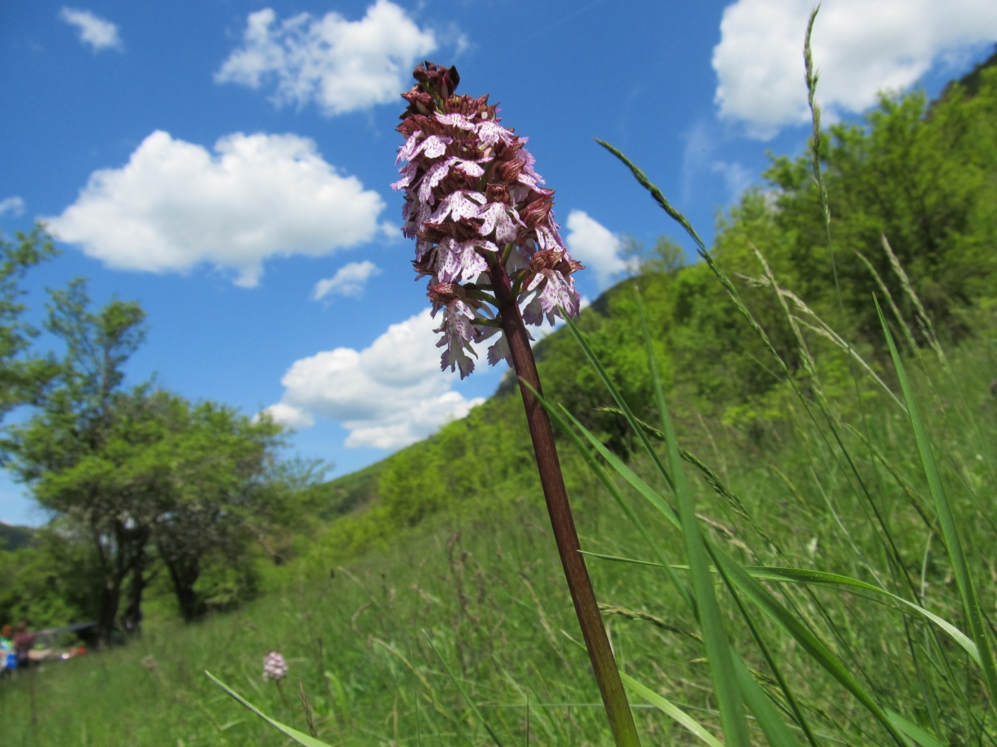
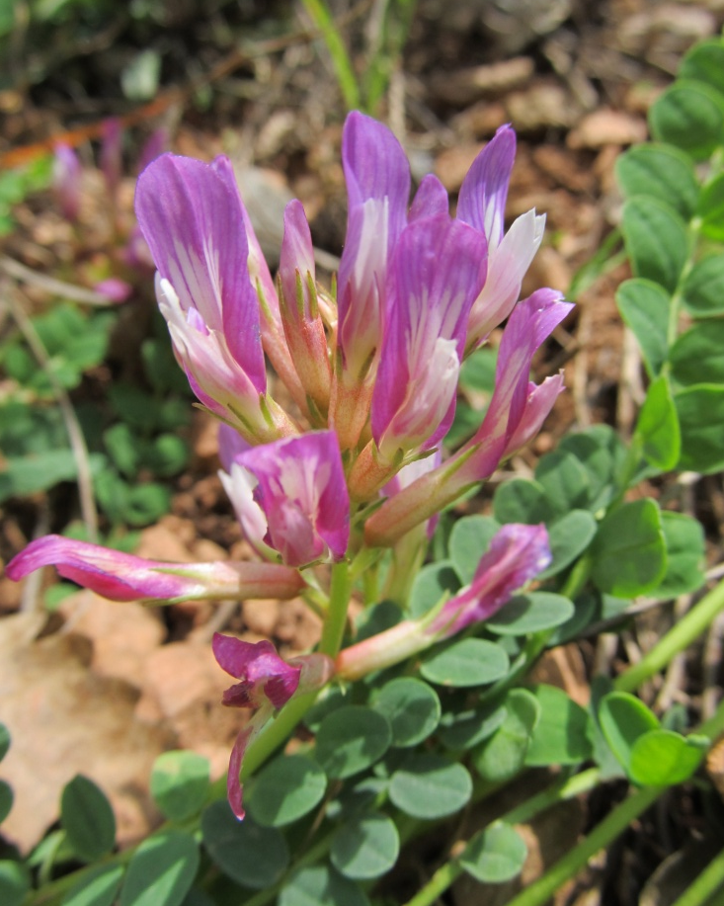
Critically endangered (CR) plant species acording to the International Union for Conservation of Nature (IUCN) in the gorge
Astragalus monspessulanus
Orchis purpurea, lady orchid

Slide 13
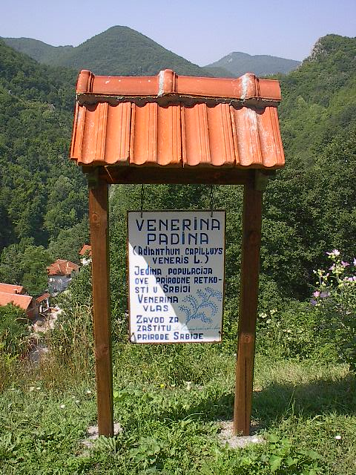
A board - marking the habitat of endangered Venus Hair Fern (Adiantum capillus-veneris)

Slide 14
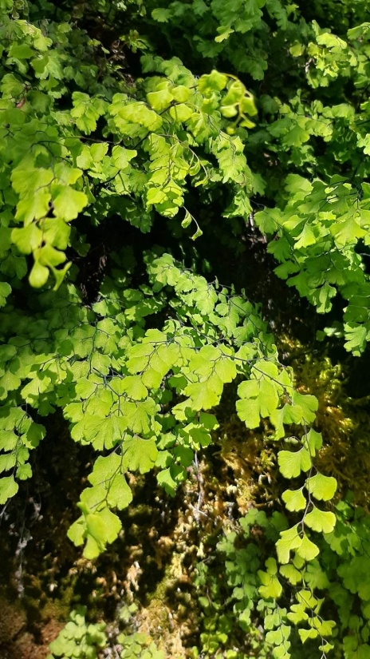
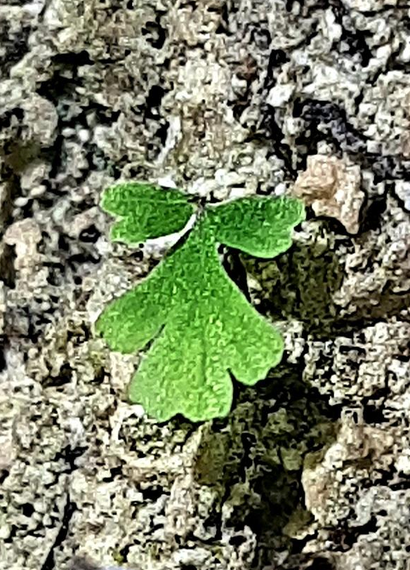
In situ protection measures - a good way to preserve species diversity
in-situ protection
In the last 20 years, several in-situ and ex-situ protection activities have been carried out. The species has been reintroduced to the habitat, and an artificial water inflow system has been established to provide the thermal water necessary for the preservation of the habitat and species.

Slide 15
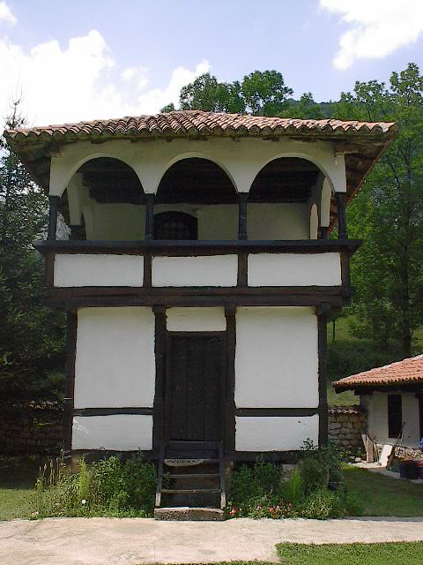
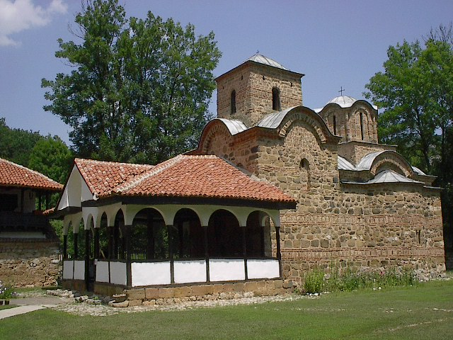
Getting to know the cultural heritage
St. John the Apostle Monastery is a Serbian Orthodox monastery situated in the protected area. This Monastery has been protected since 1949 and declared a Monument of Culture of Great Importance in 1979.

