Slide 1
Waste management

Slide 2
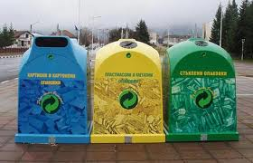
Separate collection does not completely solve the problem of municipal solid waste. Not everything can be reused or recycled. There will always be things that need to be landfilled or burned. The solution is to separately collect as much of the paper, glass, metal, plastics and everything else that can be reused as possible. If the amount of garbage is reduced, the costs of its disposal will be lowered. We need to change the way we have been disposing of garbage for years. When we get everyone involved and working together, the split collection will be more effective. It is up to us to make some effort. So if you haven't separated your waste yet, start doing so. Do everything that contributes to the protection of the environment and reduces the amount of garbage. Thus, the small daily efforts you make will have a direct and immediate effect on the world around us

Slide 3
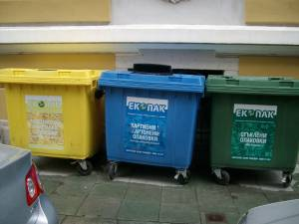
Containers
There are three types of containers - blue, green and yellow. Plastic and metal waste is disposed of in the yellow bin. Glass waste is disposed of in the green container. Paper waste is disposed of in the blue container. There are also sites with one container per household. Paper, plastic, glass and metal waste is thrown into the container.

Slide 4
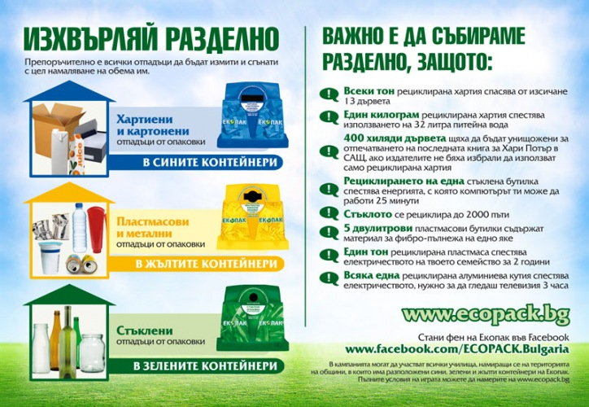

Slide 5
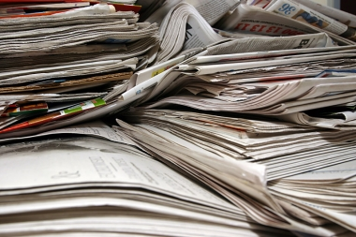

Paper
It takes the wood of 24 trees to produce one ton of newsprint. If instead of throwing away the newspapers we read, we put them in the separate collection container, we save many trees from being cut down, save huge amounts of water needed to produce virgin paper and reduce air pollution by 73%.

Slide 6
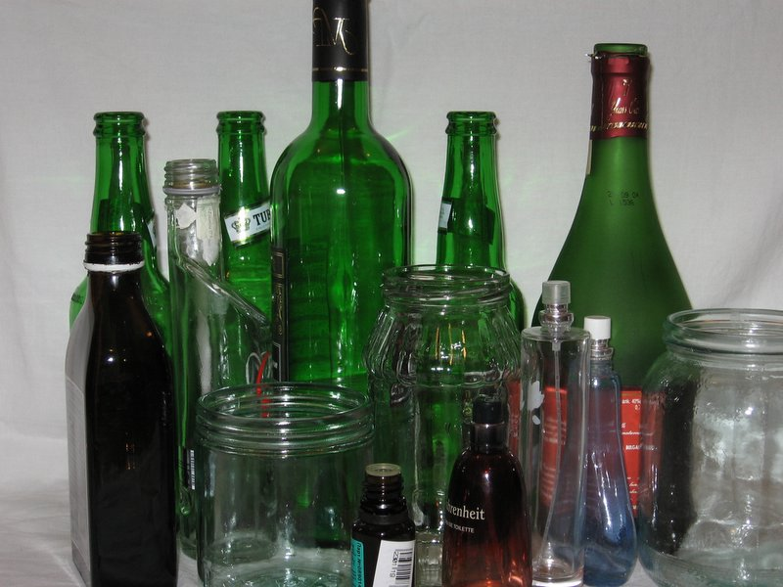
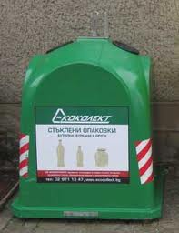
Glas
Glass does not degrade in nature (unless we have the patience to wait 4000 years for it), and at the same time it is an ideal raw material for recycling because it can be processed into new glass products an unlimited number of times. Recycling saves excess pollution - 20% of the air and 50% of the water. It also saves a lot of energy that would otherwise go into producing primary glass.

Slide 7
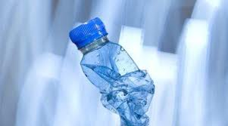
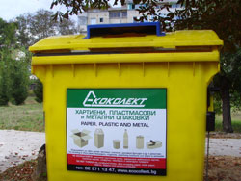
Plastic
2.5 million plastic bottles are thrown into the trash every hour in the United States alone. If not recycled, plastic ends up in landfills, where it takes 500 to 1,000 years to break down and contaminates soil and water with dangerous toxins. The production of plastic is twice as energy intensive as the recycling process. To help, we simply need to dispose of the plastic packaging in the separate collection containers.

Slide 8

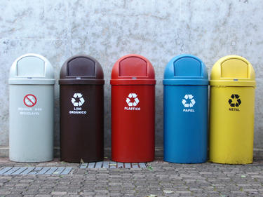
Metal
An aluminum package can be recycled an unlimited number of times. Its recycling requires only 5% of the energy needed for primary production. By collecting aluminum packaging separately, we also help to preserve aluminum ore deposits. A total of 2,100,000 kg. waste has passed through the Waste Processing Plant, which ECOBULPAK built in the capital's "Filipovtsi" district during the first 100 days of its commissioning. 1,200,000 kg. is the share of waste from the yellow containers, and 900,000 kg. are the glass packages. The data was announced during the Open Day that the company organized at the plant on August 14.

Slide 9
How should we dispose of waste?
Paper packaging that can be thrown away is: cartons, cardboard boxes, wrapping paper, etc. Before throwing away the waste, fold it as much as possible to reduce its volume.
The plastic packaging that you can dispose of separately are: Foil, boxes of cosmetic products, plastic bottles of mineral water, bottles and tubes of washing and cleaning agents; bottles of shampoos, conditioners and other cosmetic products; vials of medicinal products; plastic bags and bags. Before disposing of the waste, empty the contents and rinse them, crush the bottles to reduce the volume.
The metal packaging that you can dispose of separately are: cans of juices and soft drinks, cans, metal spray bottles of deodorants, etc. cosmetic products, metal foil. Before disposing of the waste, empty the contents and rinse them, crush the cans to reduce the volume.
The glass packaging that you can throw away are: all kinds of jars - from canned and baby food, bottles of alcoholic and non-alcoholic drinks, bottles and vials of medicines and cosmetic products. Before disposing of the waste, empty its contents and rin

Slide 10
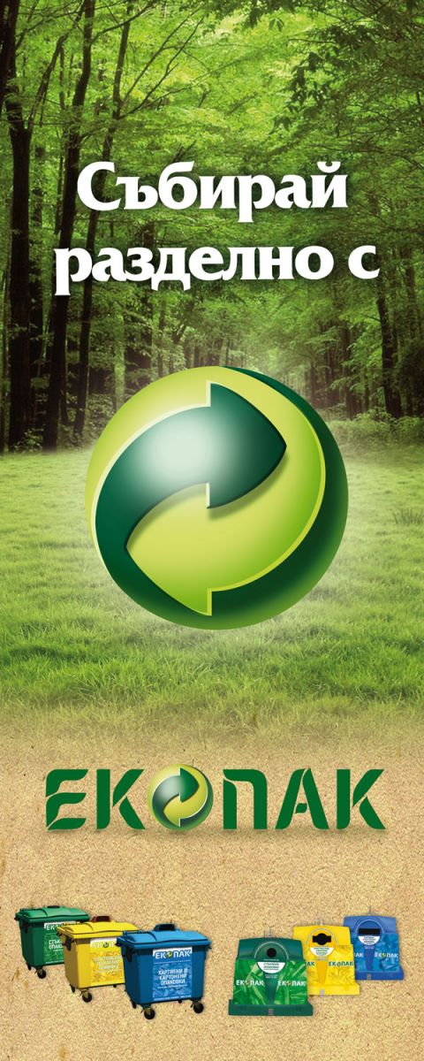
Why collect separately?
There are several important reasons that can make us think seriously about how useful it is to collect our waste separately - to save our natural resources, to make the place where we live cleaner, neater and more orderly.
The list could be much longer, but these three reasons are quite enough to make any reasonable person rethink his habits, start doing something that will make him feel really useful. It is enough to get a real idea of the things that we throw into nature with a light hand on a daily basis to realize the consequences that inevitably overtake us - if not us, then our children...

Slide 11
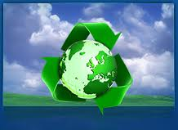
What exactly happens in the recycling process?
Have you ever wondered what happens to the waste we send for recycling? In this article, we will try to show in general terms the process of recycling plastics, paper, iron and aluminum.

Slide 12
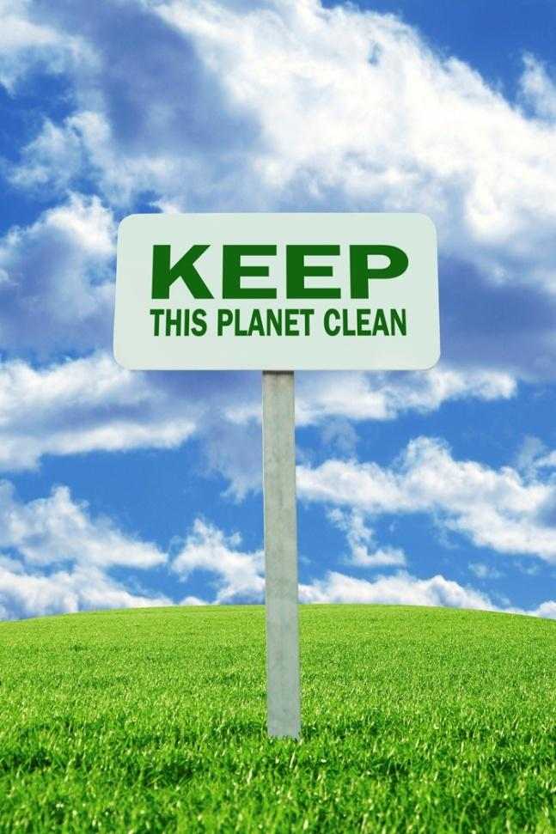
Why recycle?
About a third of the resources used become waste and harmful emissions. Housing, food and mobility take the largest share of resource use and leave the largest footprint on the environment. The long-term practice of waste disposal has a number of harmful effects on health and the environment. Waste is also a waste of natural resources, for example, metals, glass, plastic and others are recyclable, which saves the extraction of primary resources to make new products. Therefore, sound waste management can protect public health and the environment, while contributing to the conservation of natural resources, which will help future generations to exist in a clean environment.

