Slide 1


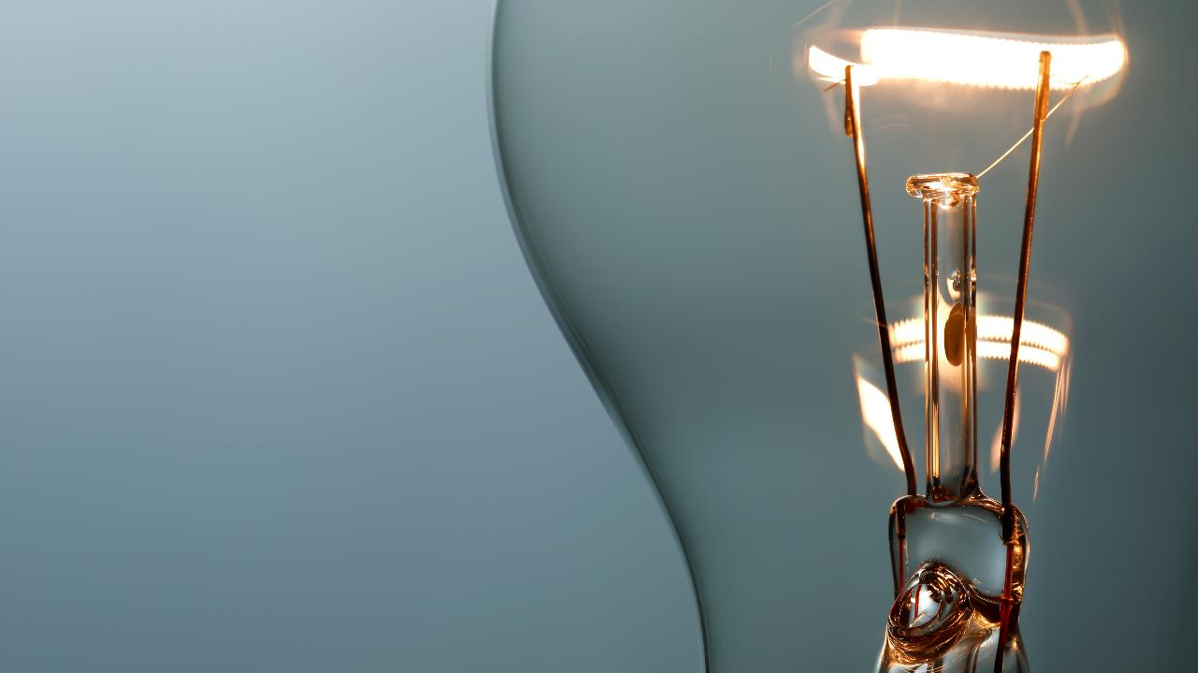
From scrap to gold: handmade art products

Slide 2

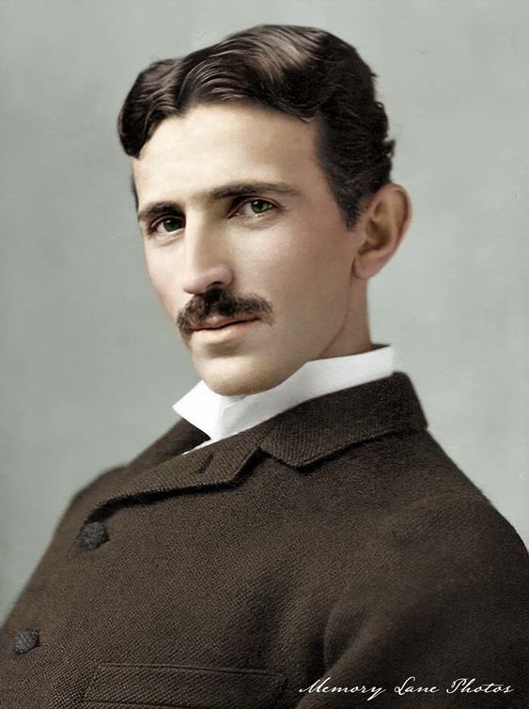
For start...
“If your hate could be turned into electricity, it would light up the whole world.”
- Nikola Tesla 1856-
∞

Slide 3
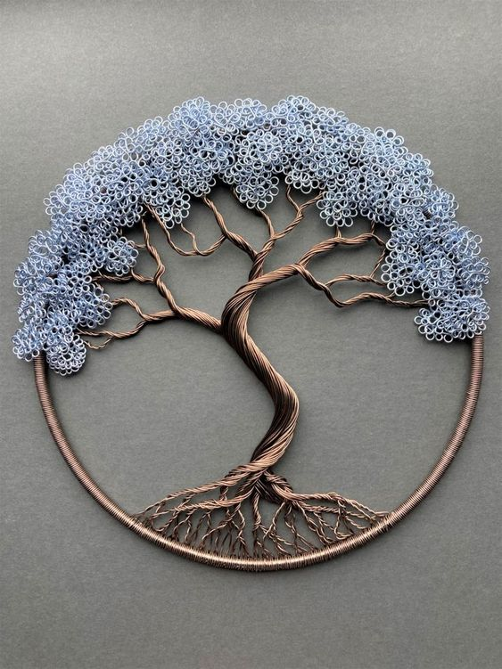




advantages of recycled products
DIFFERENT VISION
LOW POLLUTION
RECYCLING
Tree from cable wires

Slide 4
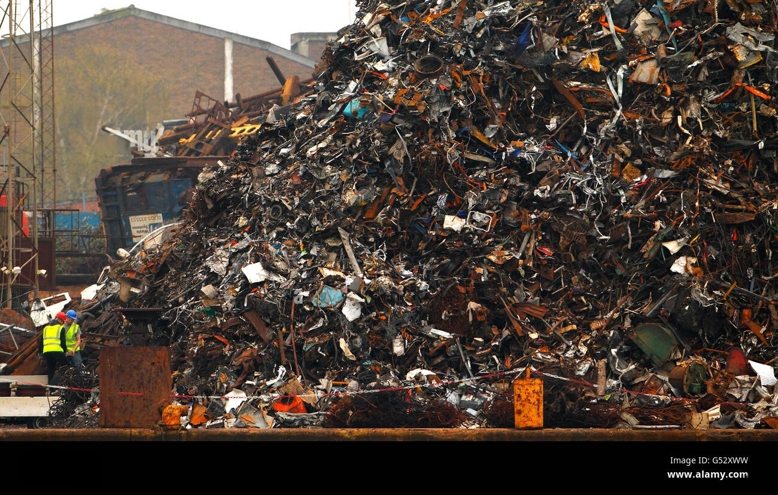
Meeting with our idea
Creating products from waste and scrap materials is a sustainable and innovative approach that contributes to environmental conservation and resource efficiency. This process involves repurposing discarded materials to manufacture new products, reducing the burden on landfills and minimizing the extraction of raw materials.

Slide 5
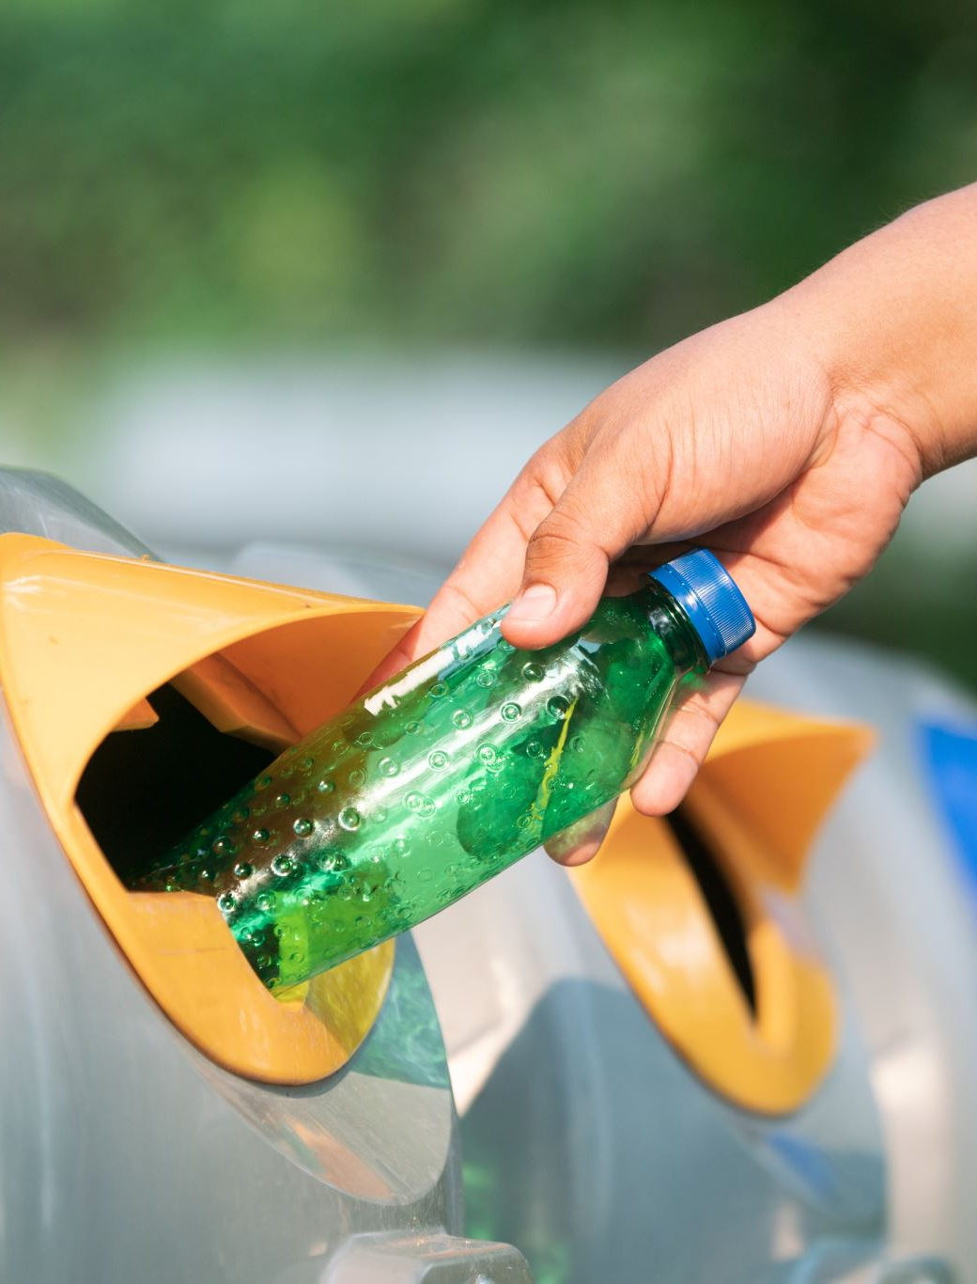
Collection and Sorting
Explanation of the initial steps in the production process.
Importance of efficient collection and sorting for quality recycled materials.

Slide 6
Process
The production process of products from waste and scrap involves a systematic approach to transforming discarded materials into new, usable items. It begins with the collection and sorting of waste materials, followed by cleaning and preprocessing to remove contaminants. Subsequently, the recycled materials are incorporated into the manufacturing process, where they are utilized to create new products. Once manufactured, these products are distributed for sale, often labeled as environmentally friendly or recycled to appeal to consumers with a focus on sustainability. Additionally, careful consideration is given to end-of-life considerations, encouraging designs that facilitate easy disassembly or recycling to contribute to a circular economy.

Slide 7
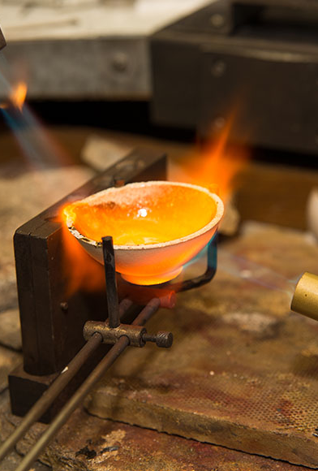
Melting or Refining (if applicable)
Explanation of the melting or refining process, particularly for metals and plastics.
Demonstration of how these materials can be transformed into new forms.

Slide 8
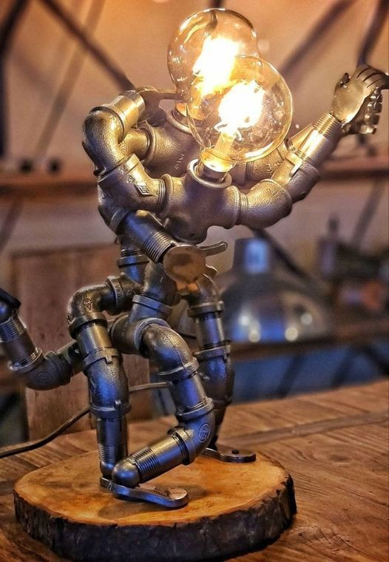
Manufacturing Process
Insight into the manufacturing techniques involved in creating products from recycled materials.
Showcase examples of products made from waste, emphasizing innovation in design.

Slide 9
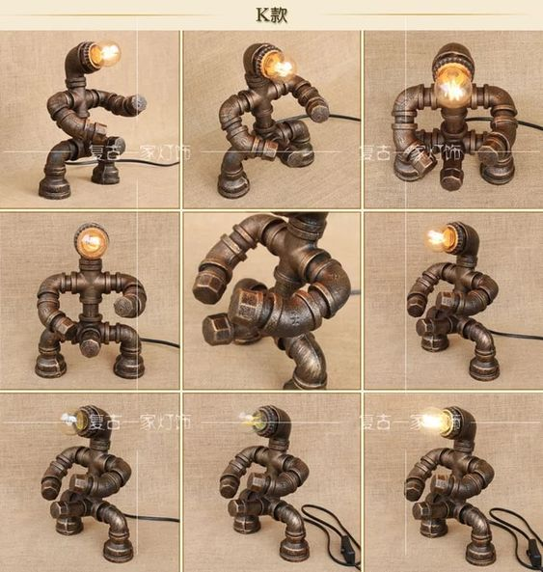
Implemented project
DESK LAMPS FROM IRON PIPES

Slide 10
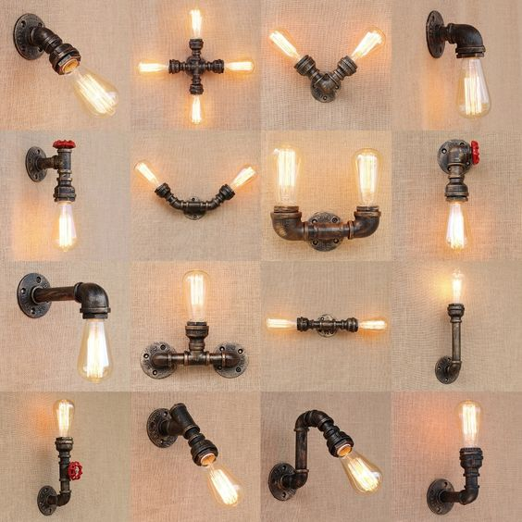
Wall sconces from iron pipe

Slide 11
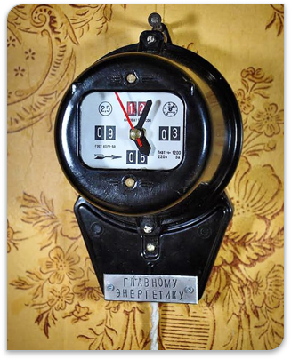
Electricity meter clock

Slide 12
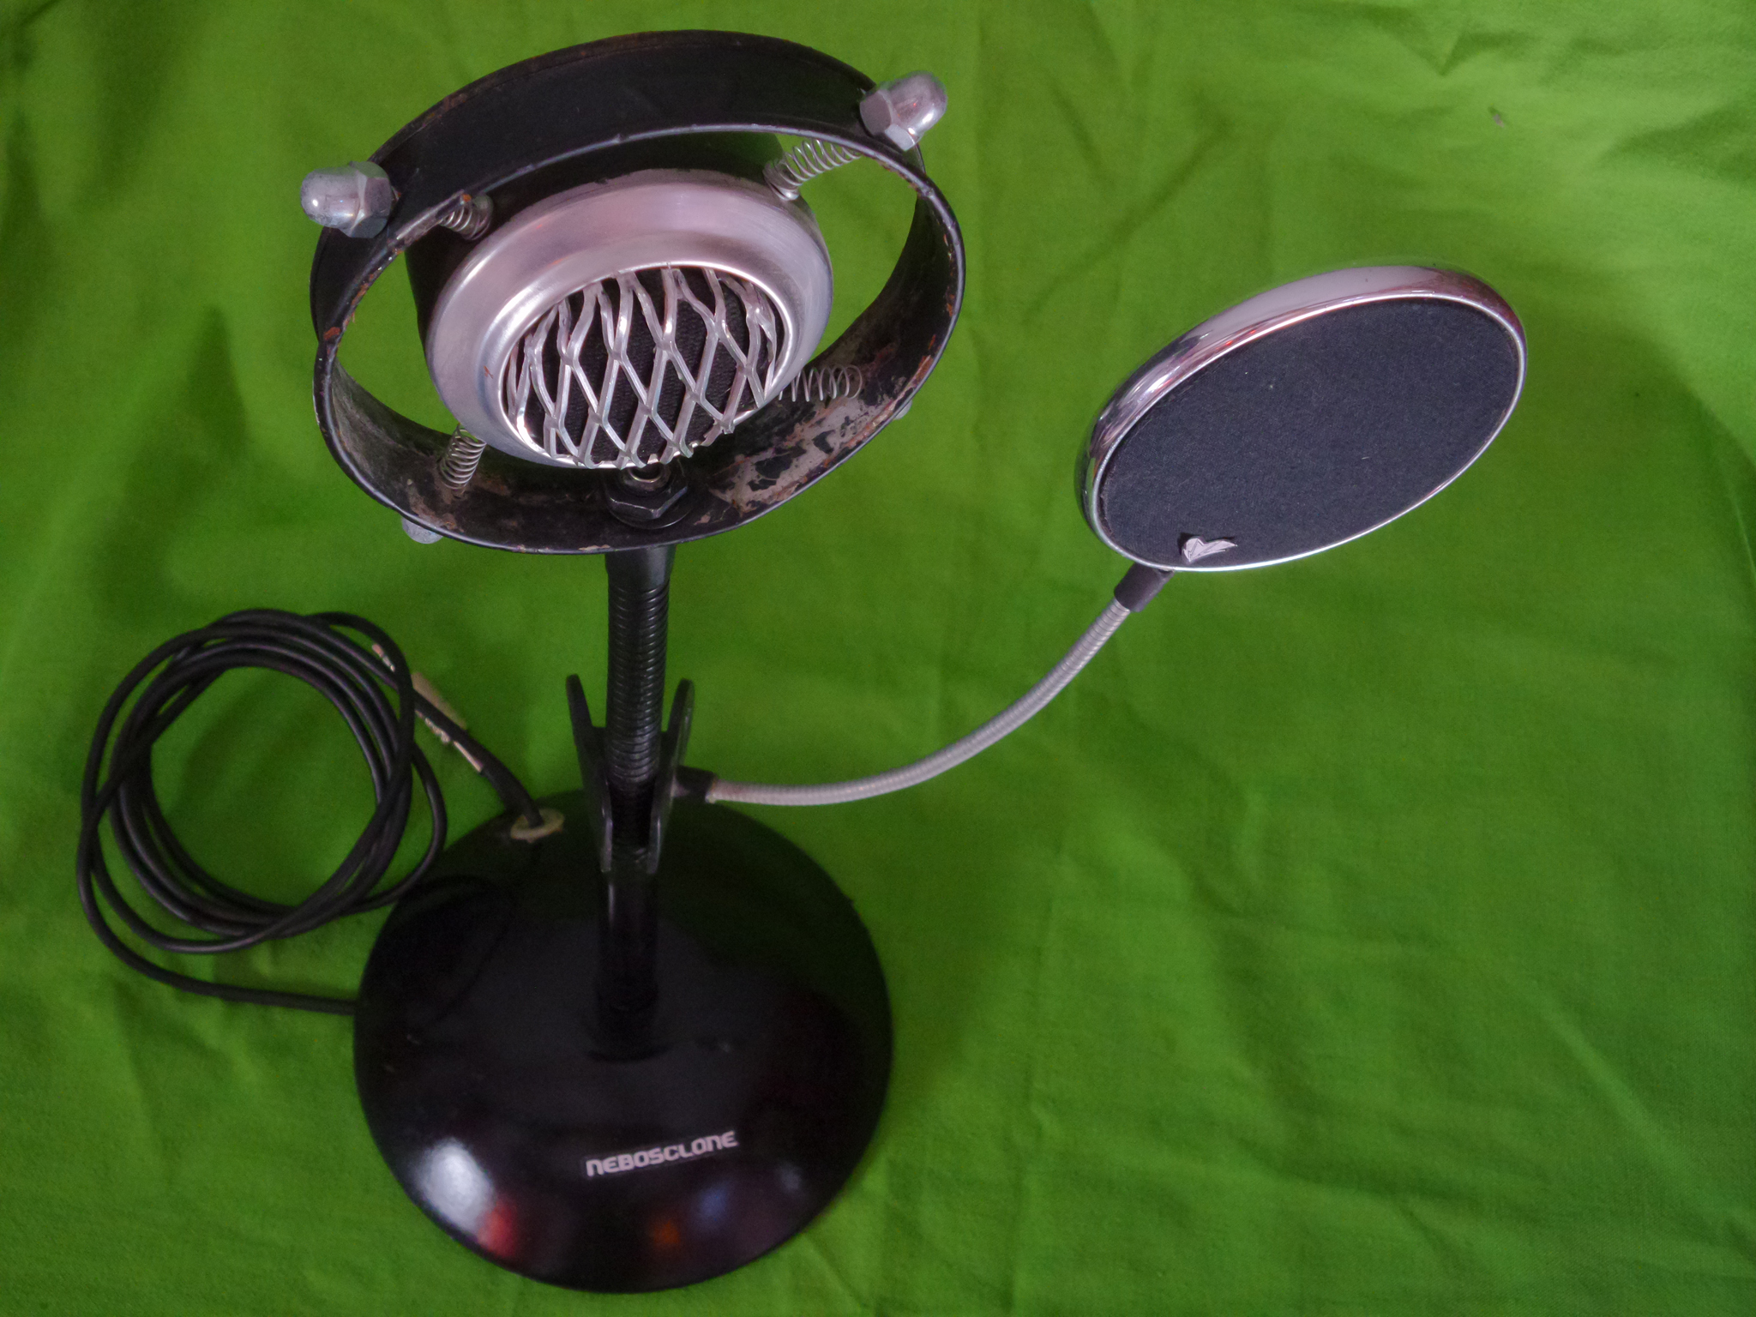
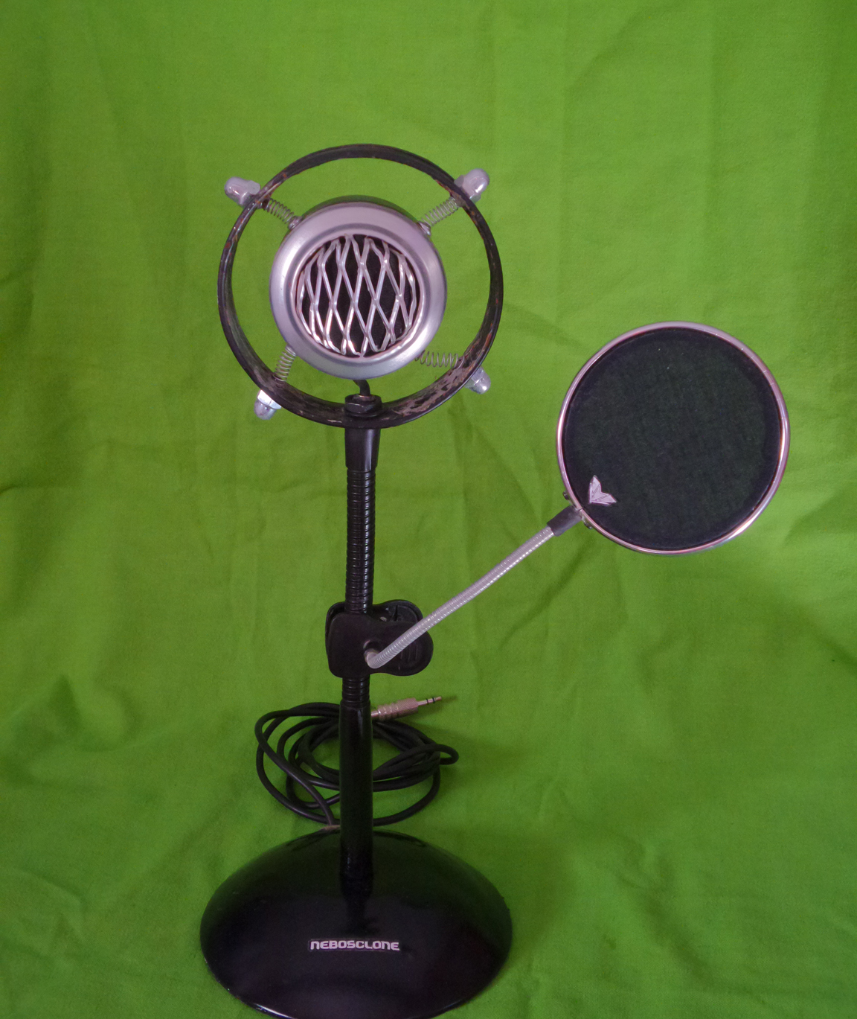
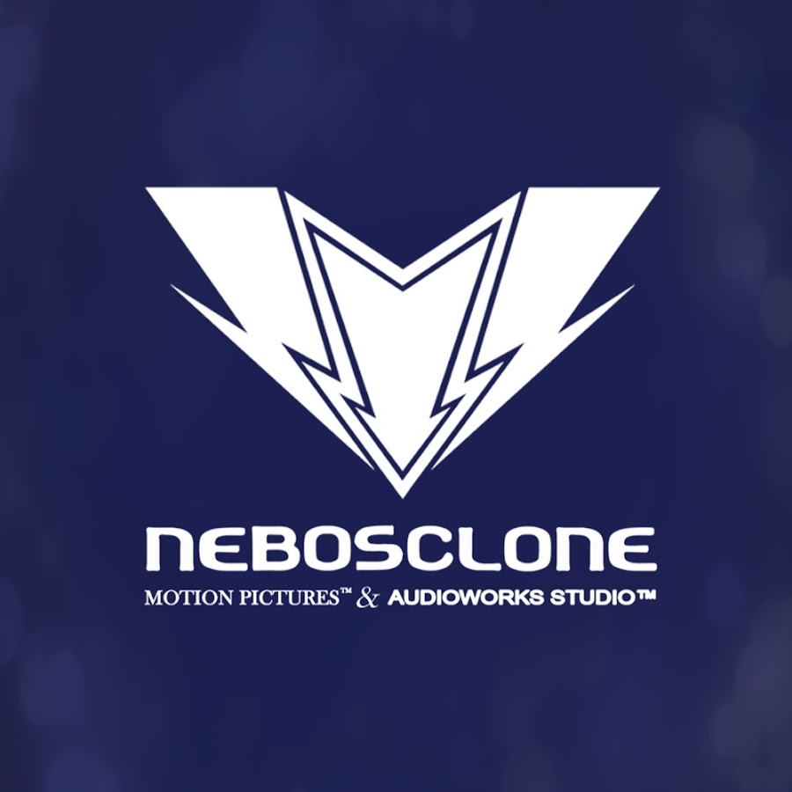
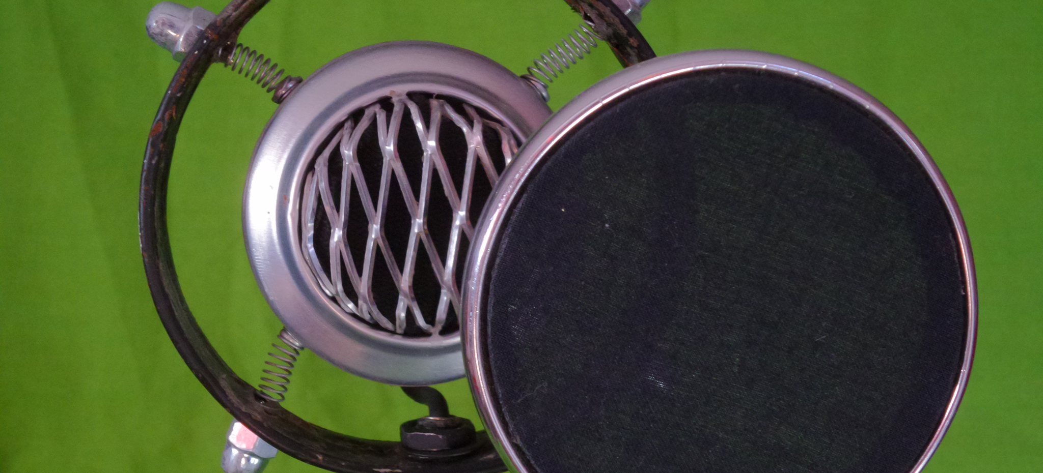
Nebosclone Studio's DIY microphone
Made from old desk lamp, aluminum cans, PVC pipes, and waste caps.​
Nebosclone studio is a little-known Bulgarian YouTuber who makes reviews of retro equipment and projects from old and non-working ones.

Slide 13
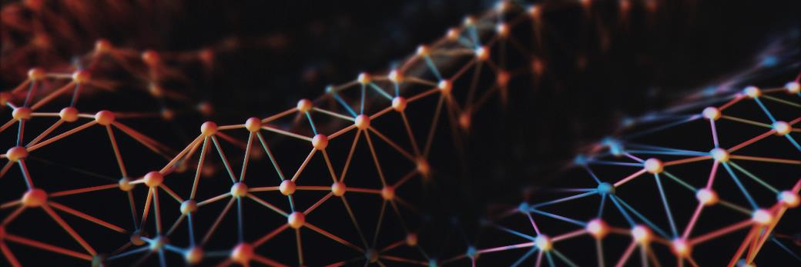
Q&A
Thanks to Georgi K. Mlyachkov- Gemlya for the assistance

