Slide 1
Management of air quality and opportunities to reduce atmospheric pollution

Slide 2

►Convection for long-range transboundary air pollution
►EU legislation.
►European strategies and programs.

Slide 3
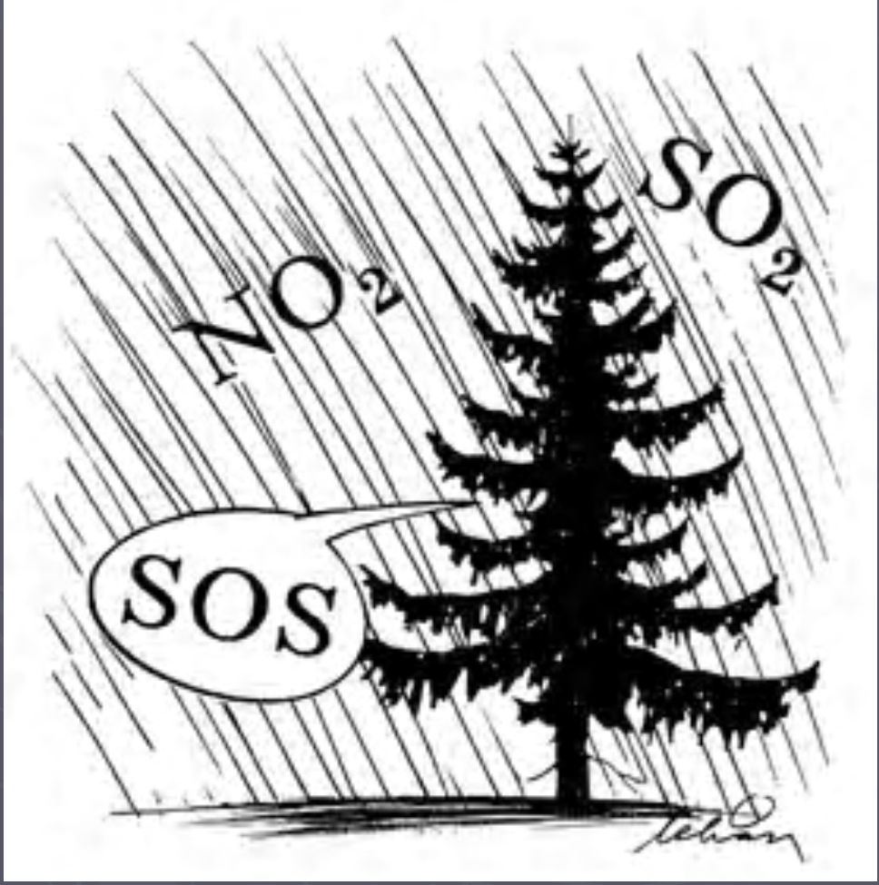
Convection for long-range transboundary air pollution

Slide 4
It was in the 1960sestablished direct relationship betweensulfur emissions in continental Europe andthe oxidation of the Scandinavian lakes.
In 1972, a UN conferencesignaled the beginning of an internationalcooperation to preventenvironmental problems such as oxidation○
1972-1977 it was found that the pollutantsof the air can spread onthousands of kilometers before they break down;

Slide 5

Convection for long-range transboundary air pollution
The Convention was signed in 1979 in Geneva by the governments of 34 countries and the European Community and entered into force in 1983;
It is the first international regulatory document related to governance ambient air quality on a regional scale;

Slide 6
Basic Principles
Limitation and gradual reduction and prevention of air pollution, including long-range transboundary pollution /art. 2/

Slide 7
Exchange of information, scientific activity and technical measures aimed at combating air pollutant emissions that may have negative consequences for reducing air pollution, including long-range transboundary air pollution /art. 4/
Timely consultations between the countries on which the adverse consequences of transboundary air pollution actually spread or which are exposed to a significant risk, and between the countries in whose borders and jurisdiction a significant share of transboundary air pollution occurs or may occur / art.5 /.

Slide 8
Results of the entry into force of the Convention:
Over a thousand scientists and experts are connected in an information network, which greatly increases the exchange of information;
A Joint Program for the Monitoring and Evaluation of Long-Range Air Pollutant Distribution in Europe has been developed, which provides industries and institutions with quality scientific information.
An Effects Working Group was established to provide information on the extent and geographic distribution of human health and environmental impacts of major air pollutants such as sulfur and nitrogen oxides, ozone and heavy metals.

Slide 9
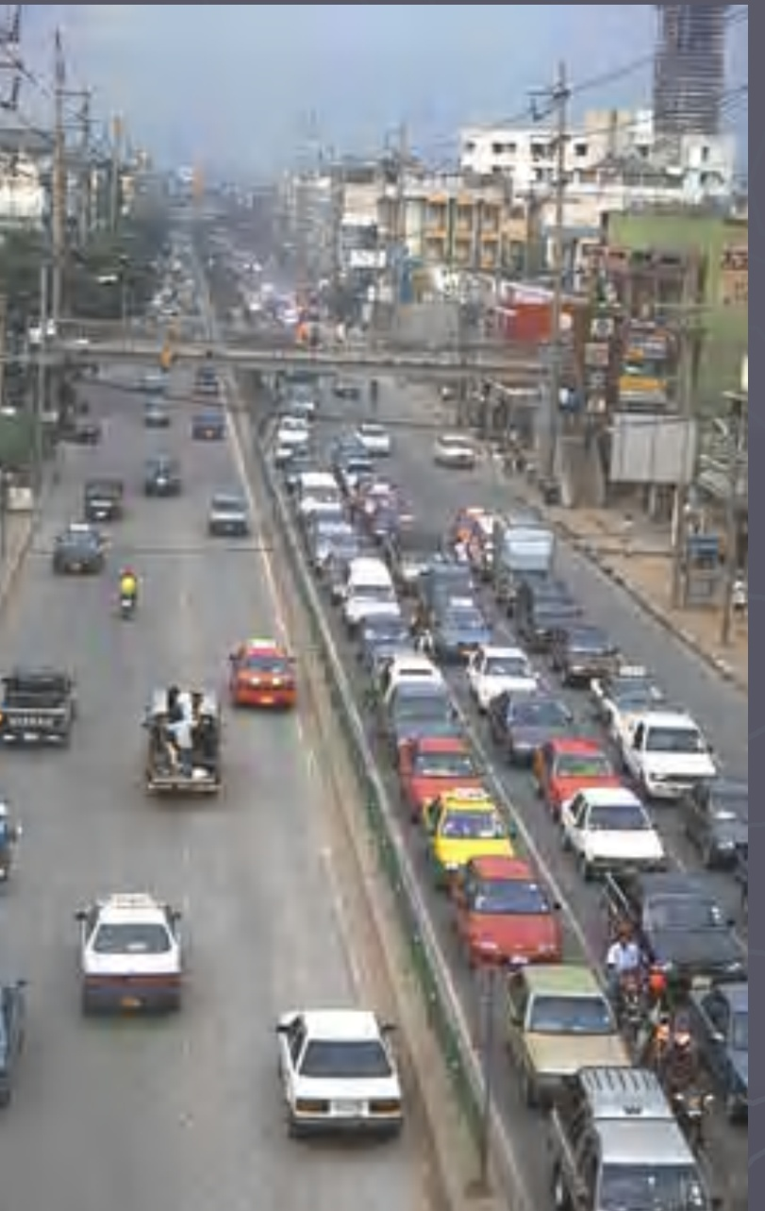
Directive 98/70/EU on the quality of motor fuels:
Technical specifications for motor fuels based on health and environmental effects are established.
Member countries commit to phasing out the use of leaded gasoline by the year 2000.
Diesel fuels can only be used if they meet specific EU quality requirements.

Slide 10
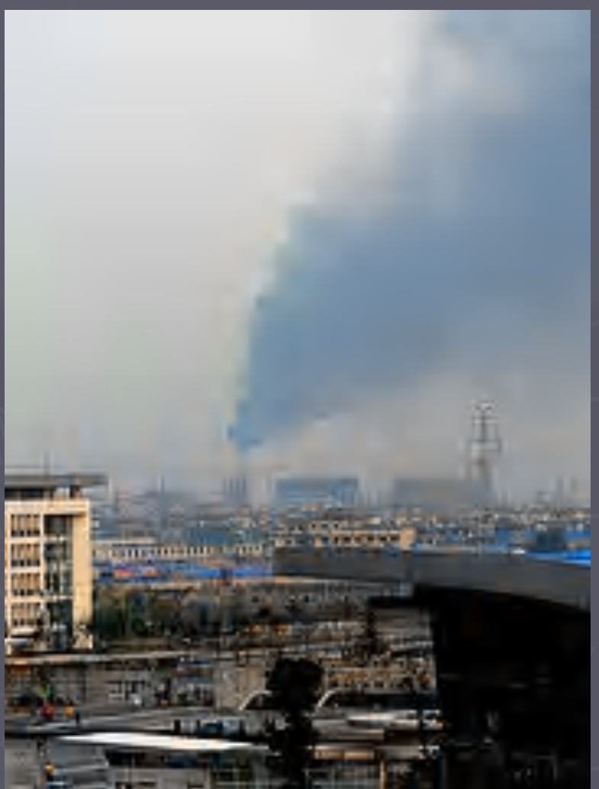
European legislation related to the management of CAV:
Directive 1999/13/EU limiting emissions of solvents in certain production activities: Enterprises must install the relevant equipment to reduce emissions to the MPC or implement a scheme to reduce emissions by replacing high solvent products with low solvent products.

Slide 11

Directive 97/68/EU onmeasures to limitoff-road emissions(self-propelled) machines:
Through this Directive,equate the legal arrangements ofthe member countries foremission norms and waysto issue typesengine permits forincorporation into mobile machineryand appliances.

Slide 12
Directive 2001/81/EC on national emission thresholds for certain pollutants:
The purpose of emission thresholds is to achieve the following environmental objectives:
reduction of critical acid load areas by at least 50% compared to 1990 values;
(b) levels of ozone pollution above the limit threshold for human health should be lowered with 2/3 of the values in 1990.

Slide 13
European strategies and programmes:
Thematic strategy on the pollution ofatmospheric air Long-term goals:
► A 47% reduction in the expected loss of life as a result of exposure to certain substances;
► 10% reduction in mortality from exposure to ozone pollution
► Reduction by 74% and 39% of the acidification of forest areas and surface waters, respectively;
► Reduction by 43% of areas or ecosystems exposed to eutrophication. To meet the long-term targets, SO2 emissions need to be reduced by 82%, NOx emissions by 60%, VOC emissions by 51%, ammonia emissions by 27%, and PM2.5 emissions by 59% compared to values in 2000.

Slide 14
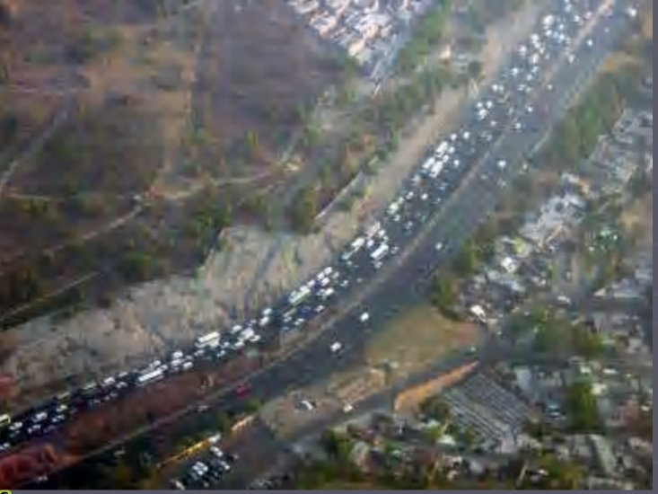
European strategies and programmes:
European strategy for transport and the environment: The strategy takes into account the positive results of some EU-level measures, but emphasizes the need for further development in the following areas:
► Avoiding or eliminating the negative effects of increased traffic through urban planning measures;
► Encouraging the use of public transport, combined transport and transport that is less harmful to the environment (eg railways and inland waterways);
► Research and technological development to reduce CO2 emissions and noise;

Slide 15
Conclusion
European strategy for transport and the environment: The strategy takes into account the positive results of some EU-level measures, but emphasizes the need for further development in the following areas:
► Avoiding or eliminating the negative effects of increased traffic through urban planning measures;
► Encouraging the use of public transport, combined transport and transport that is less harmful to the environment (eg railways and inland waterways);
► Research and technological development to reduce CO2 emissions and noise;

