Slide 1
WHY ENERGY EFFICIENCY?

Slide 2
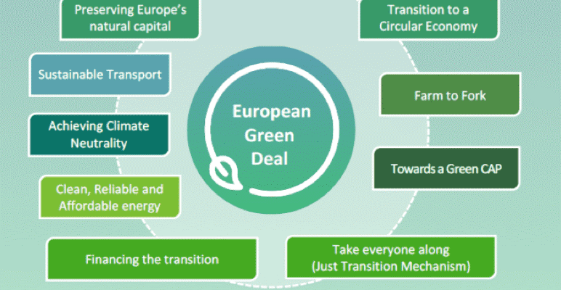

Slide 3

Achieving all European Green goals is defined by increasing ENERGY EFFICIENCY
In a world where we like to flaunt our allegiance and show our actions, being energy efficient is like being a silent hero, working for one's own sake, and for the planet's.
“Money spent in energy efficiency is not a cost, but rather an investment into a more sustainable future. Climate change and energy transition is one of the biggest challenges of this century. Renew Europe will remain vigilant” - Nicola Danti (Italia Viva, Italy), Renew Europe Vice-President

Slide 4
Energy efficiency?
Energy efficiency ?
The realized result in services, goods or energy
Spent energy
Equal/greater volume of production, quality of service or other activities performed
Reduction of energy consumption
Energy efficiency is the relationship between the energy used and the achieved result in services, goods or energy
Notes:
Енергетска ефикасност јесте однос између утрошене енергије и оствареног резултата у услугама, добрима или енергији (Закон о ефикасном коришћењеу енергије)

Slide 5
Energy efficiency ?
The concept of energy efficiency
Savings
EE should not be equated with savings or reduced consumption, which are the result of either a lack of energy to perform some activity or excessively high energy prices.
Notes:
Не треба поистовећивати ЕЕ са штедњом или смањеном потрошњом који су последица или недостатка енергије за обављање неке делатности или превисоке цене енергије.

Slide 6
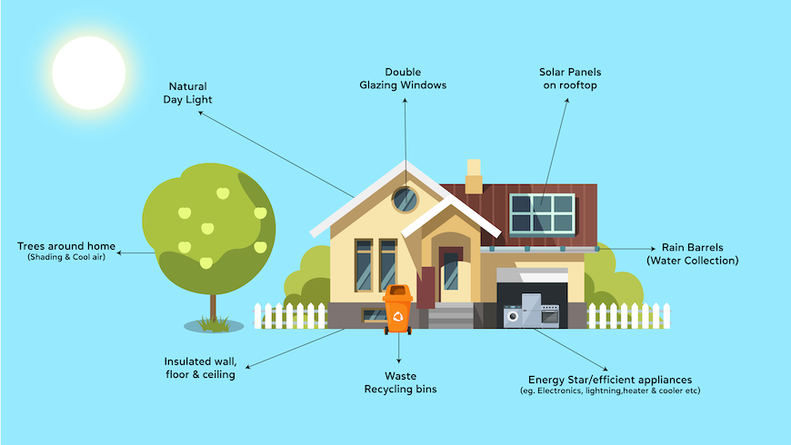

Slide 7
