Slide 1
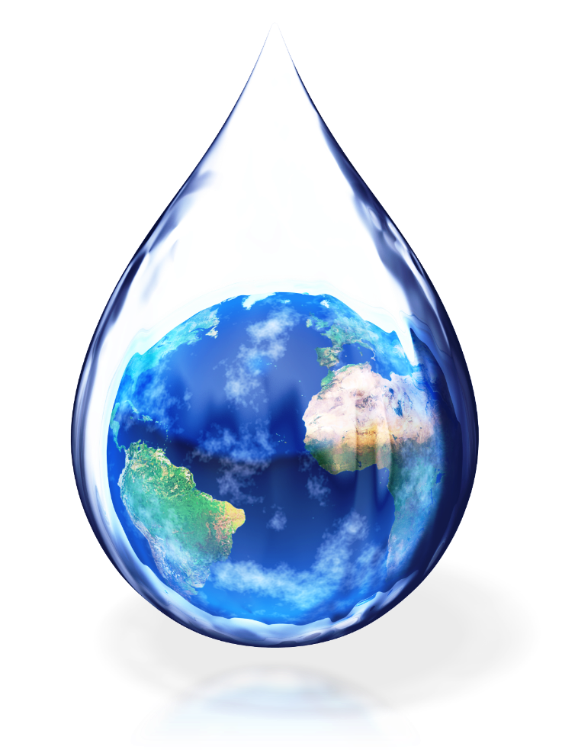
Water in the sustainable economy

Slide 2

Water and its purpose
Water is as important to the economy as it is to human life. It is needed for the production of food, fiber, hydroelectric power and more. It is a direct ingredient in almost all production processes. It is important for maintaining the ecosystems in which people live and on which they depend. Water is a valuable environmental resource.

Slide 3

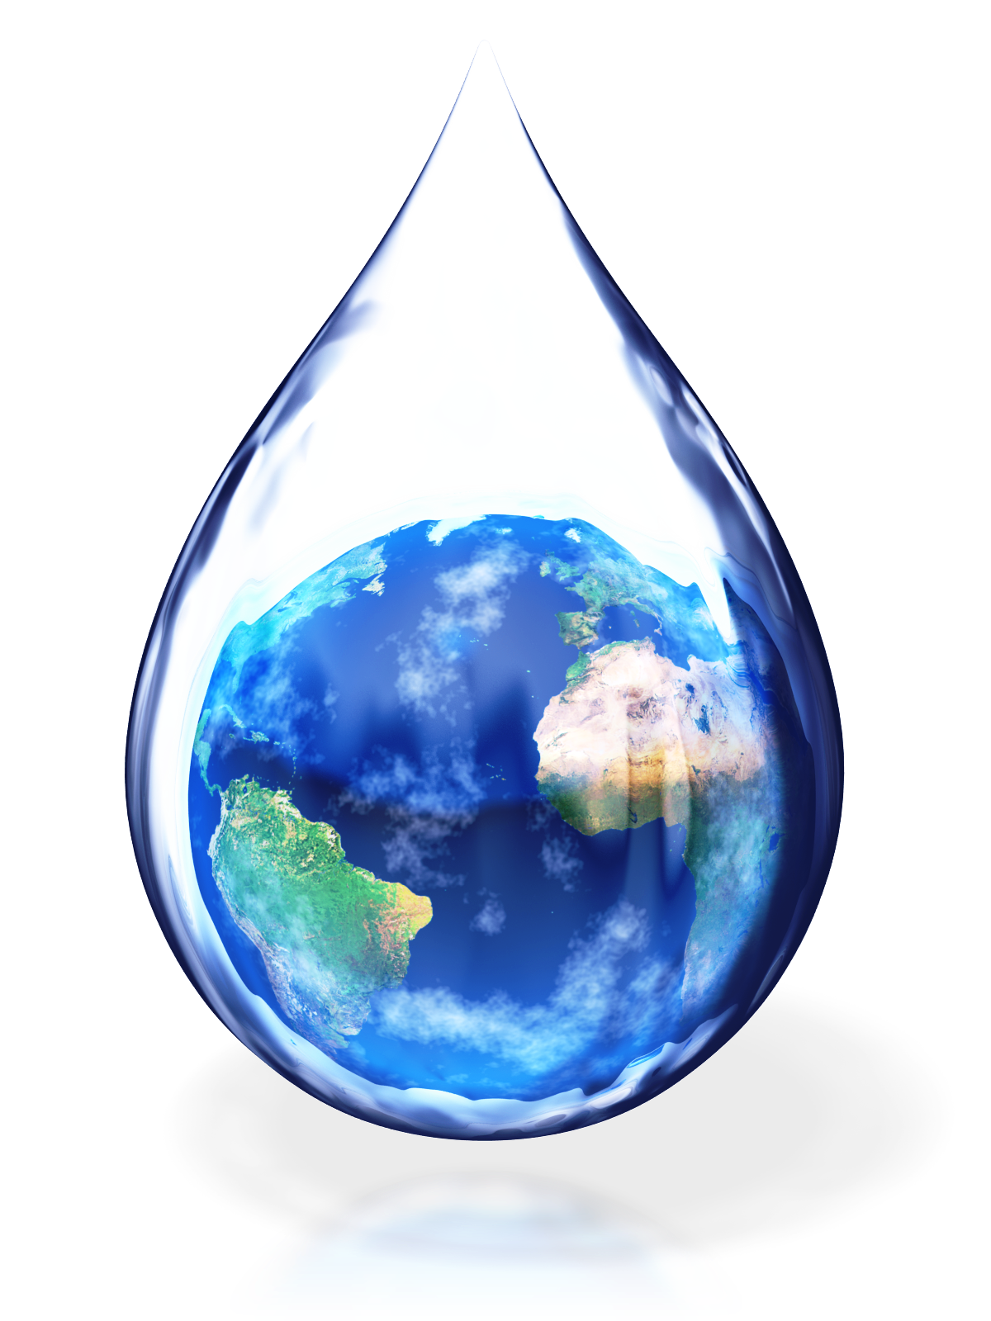
The recognition of water as a value comes as society faces its increasing scarcity. In the last century, water consumption has increased sixfold. 50 years ago, people did not see water as a globally scarce resource, but today the race for clean water in many regions is becoming normal. Water scarcity is due to:
the growth of the economy
population growth
lifestyle change

Slide 4

Growing demand and an intensifying race for water mean that choices must be made:
For the distribution of water
About the ways in which water is used
Paradoxically, an increased understanding of the value of water to the economy and the looming scarcity is an opportunity to move towards a more sustainable global economy.

Slide 5




Water in today's economy
Over 70% of the world's water is used for the production of dietary fiber in agriculture. Industry consumes the other 20%, and less than 10% of the world's extracted fresh water is used for drinking and hygiene purposes. Water supporting ecosystem services is excluded from these global accounts.

Slide 6


As a major user of water, agriculture is at the heart of the water management challenge. A person needs an average of 2 to 5 liters of water for drinking, and the average daily amount of water for food is 3000 liters. For example, the production of one hamburger requires over 10,000 liters of water, taking into account the amount needed to produce grain to feed the calves.

Slide 7
The International Water Management Institute recently determined whether there will be enough water for production in 2050. This is entirely possible only with changes in production and environmental management. The global water balance is profoundly influenced by numerous global trends related to agricultural production:
the growing population
the changing way of eating
trade in food and fiber products
production of biofuels

Slide 8
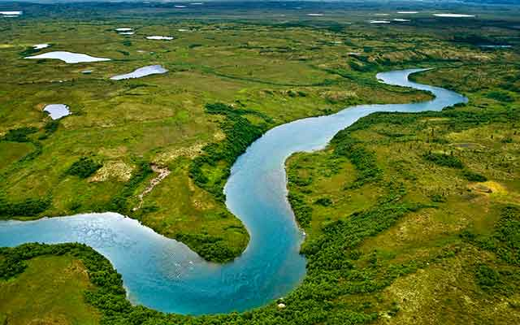
Drinking water and sanitation have a relatively modest share of the global resource. Worldwide, 1.1 billion people lack access to improved water supplies and 2.7 billion lack sanitation. In 2000, the world community agreed to define the MDGs, which include halving the proportion of people without access to water and sanitation.While the three main water users fight for an even bigger share, ecosystems are the biggest losers. To function normally, they need clean water. To maintain ecosystems, societies must take care of the natural outflow of rivers and leave them with good quality water. This is called "ecological runoff."

Slide 9

Large-scale management and water equity
Water scarcity is considered at three levels:
local
national
international
Trade in commodities that embody large quantities of water can also transcend the local nature of this resource. Water must be moved from regions of abundance to regions of scarcity.The "Human Development Report 2006" prepared by the United Nations Development Program highlights the fact that the water crisis is caused by poverty, inequality and the physical scarcity of water.

Slide 10
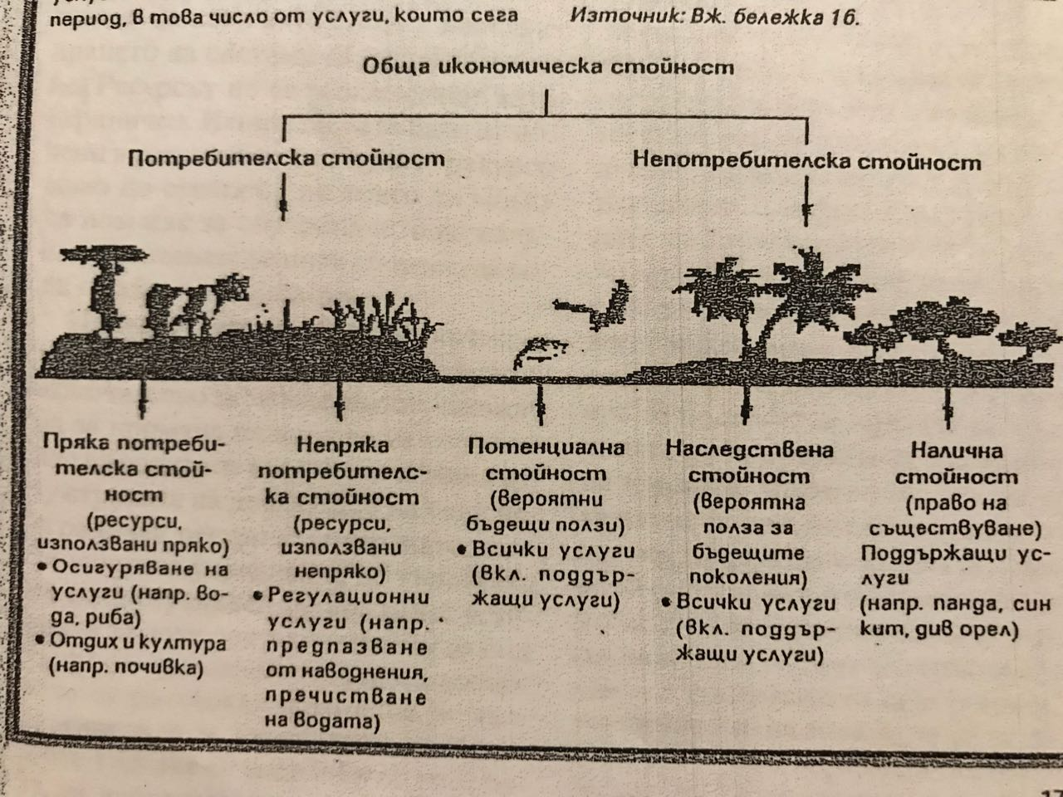
The value of water as a resource is evident in all economies. The price of water is far below its real economic value and often even below the cost of delivering it. Investment is made in water treatment plants or dams that increase national wealth, but no investment is made in wetlands, river basins or underground water sources although they perform the same functions.

Slide 11
In January 2002, the International Conference on Water and the Environment was held. Nearly 500 government experts and representatives of non-governmental groups from around the world reviewed the Dublin Principles:
Fresh water is a limited and vulnerable resource
Water development and management should be based on a participatory approach
Women have a central role in the provision, management and conservation of water
Water has an economic value and should be treated as an economic commodity

Slide 12

Many people held the view that water is a "gift of nature" or a "basic human right" and should therefore be provided free of charge.Principle 4, on the economic value of water, was included to emphasize the importance of realizing the full range of economic values that can be derived from the efficient and equitable allocation of water resources to the cost-effective provision of water services.

Slide 13
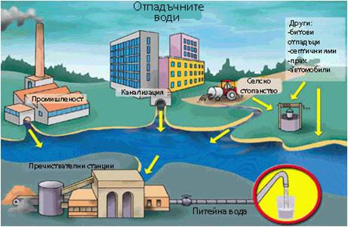

Innovations that overturn trends
Storage and delivery.
Allocation and Pricing.
Use and reuse via water purification.

Slide 14
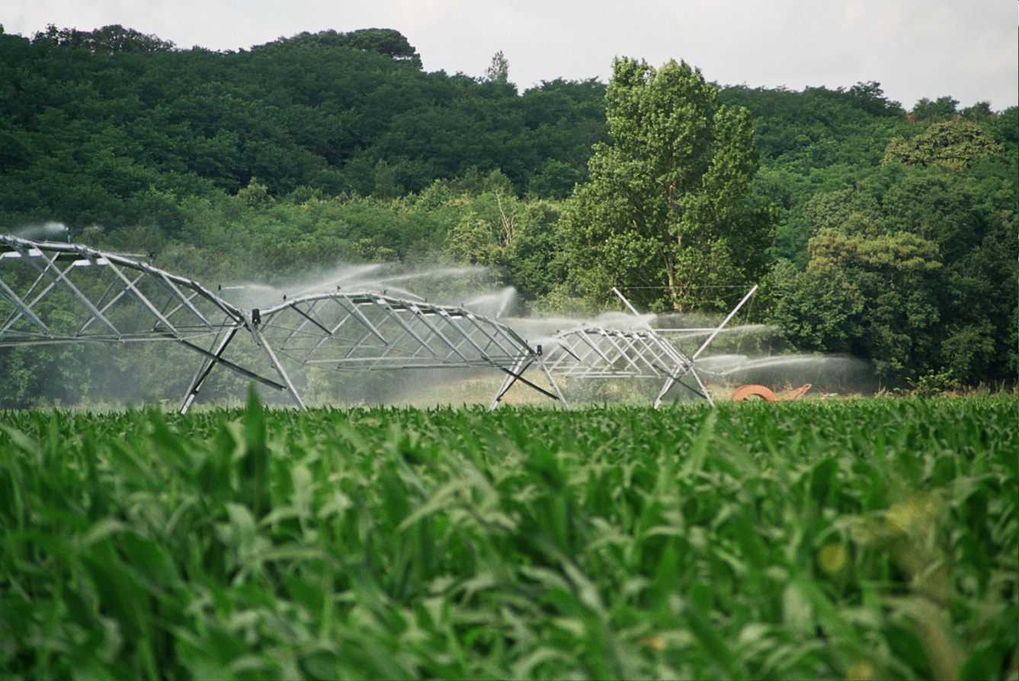
The adoption of proven good agronomic practices in many countries can lead to real improvements in water productivity.

Slide 15
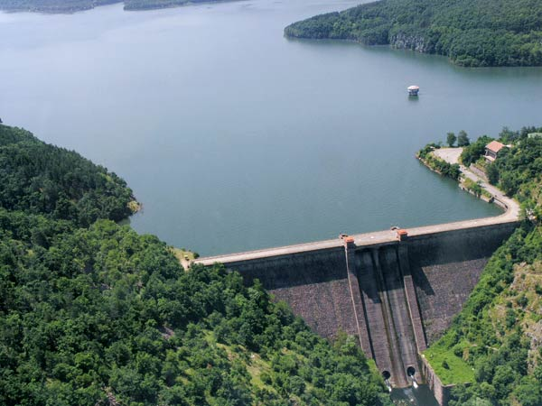
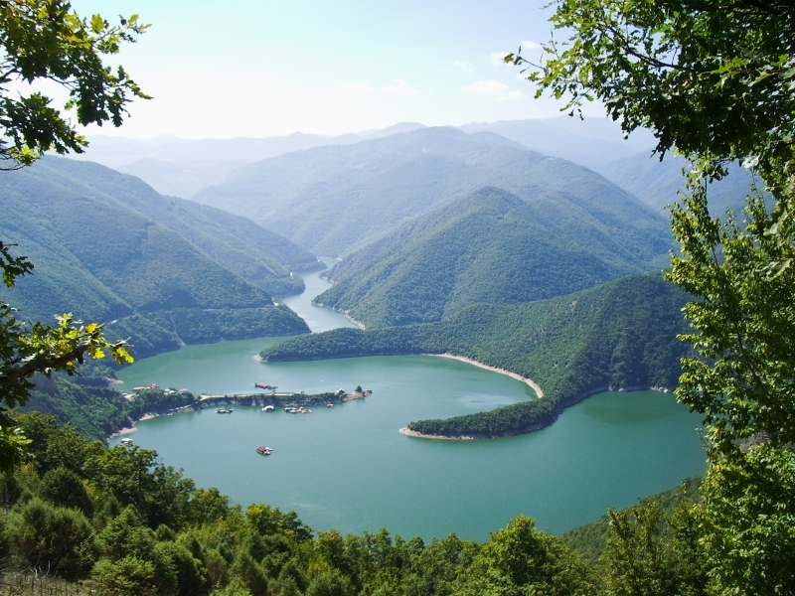
New management introductions
Basin Level Management Organizations.
Creating ecological flows.

Slide 16


Innovations in market mechanisms
Price of water.
Responsibility for its use.
Caring for the resources we pay for.

Slide 17

Commerce
Trade can also influence water management decisions. Global trade in agricultural commodities can exacerbate water stress and ease pressure on ecosystems.

Slide 18

Payment for ecosystem services
It is a market instrument that seeks to create incentives to maintain water resources or to pay for river basin services. Four approaches stand out:
private pay schemes
quota trading according to a certain minimum or maximum
environmental goods certification schemes
public payment schemes, including tax mechanisms

Slide 19

Ecological taxes
Environmental charges are fiscal mechanisms that can be used to ensure that some or all of the external costs of land use are accounted for in the decision-making process.
Taxes can be used as a positive incentive when people are freed from them or as a negative one - to discourage consumption and activities that are harmful to the environment.

Slide 20
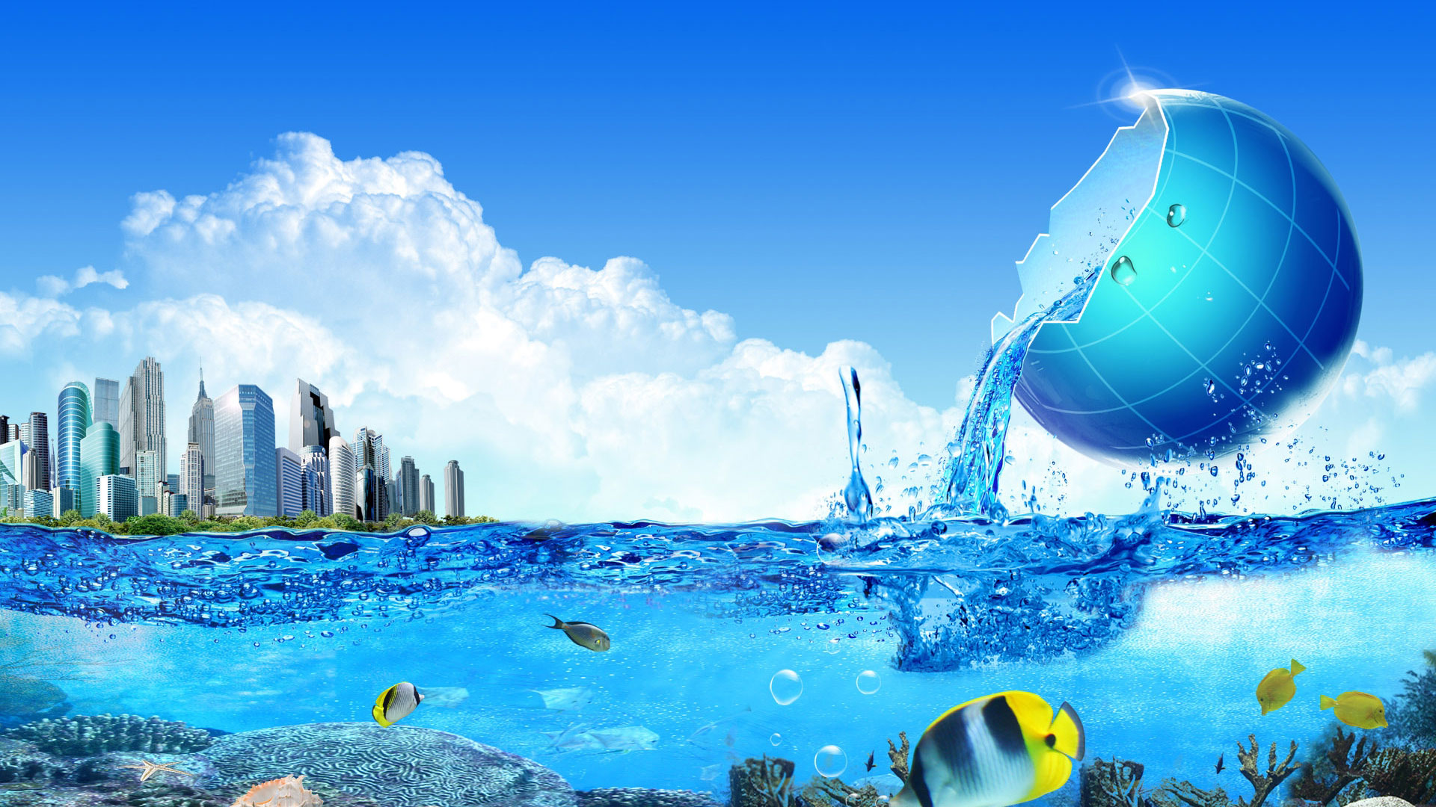
Coordinating economic and water policies
Water management affects the functioning and structure of the economy, and economic policy affects the state of water resources.

Slide 21
In a sustainable economy, social, economic and regulatory incentives must be aligned to support:
sustainable patterns of water consumption
distribution of waters in the interests of present and future well-being
water investments, technologies and practices that support efficiency, water quality, conservation and ecosystem integrity.

