Slide 1
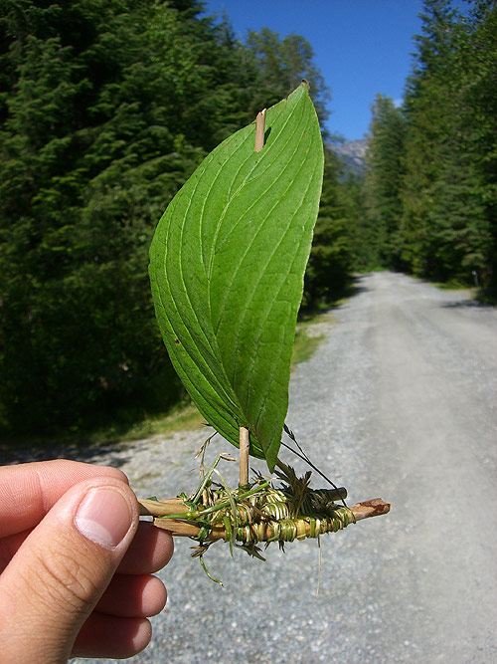
Geo-ecological monitoring of environmental pollution in Bulgaria

Slide 2
Explanation of the term pollution
The introduction into a given environment of new, uncharacteristic substances or exceeding the level of their normal average annual concentration. Pollution can be caused by natural (natural) factors or anthropogenic (result of human activity)

Slide 3
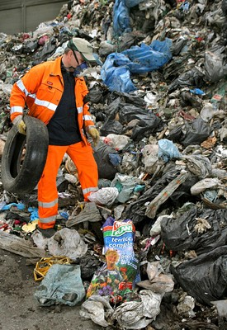
Types of pollution
The main objects exposed to pollution are: water, air, soil.
Indirect objects are: people, plants and animals.

Slide 4
How industrial enterprises pollute the natural environment?
Among the biggest sources of pollution is industry, and especially some of its branches: the chemical and pulp and paper industry, non-ferrous and ferrous metallurgy, electricity generation in thermal power plants, etc. Gases, dust, ash, aerosols, waste water and other products enter the environment.

Slide 5
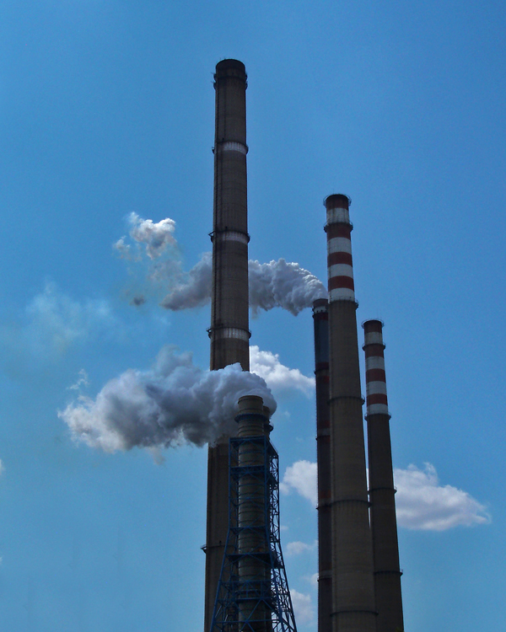
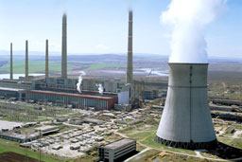

Slide 6
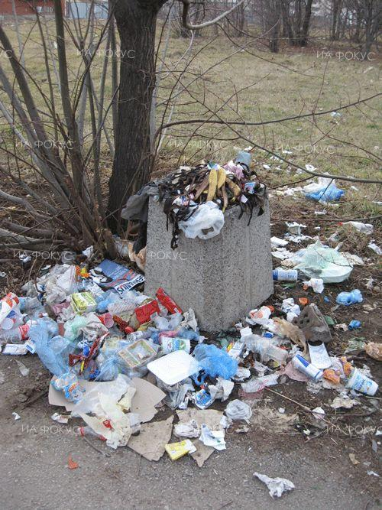
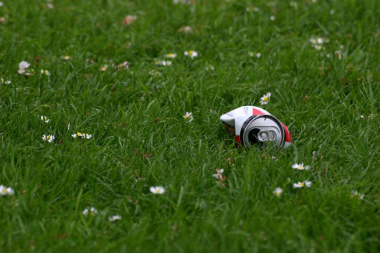
Soil pollution
One of the main soil pollutants are heavy metals such as chromium, cadmium, zinc and lead, which are waste materials in some types of production.

Slide 7
Water pollution
The water is mainly polluted by waste water discharged from factories and other enterprises and oil spills from tankers. Industrial production has led to the appearance of critically polluted sections in many rivers in Bulgaria and around the world. The largest share in water pollution is the chemical industry.

Slide 8
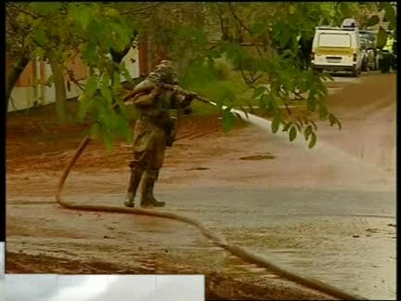
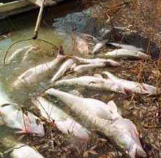
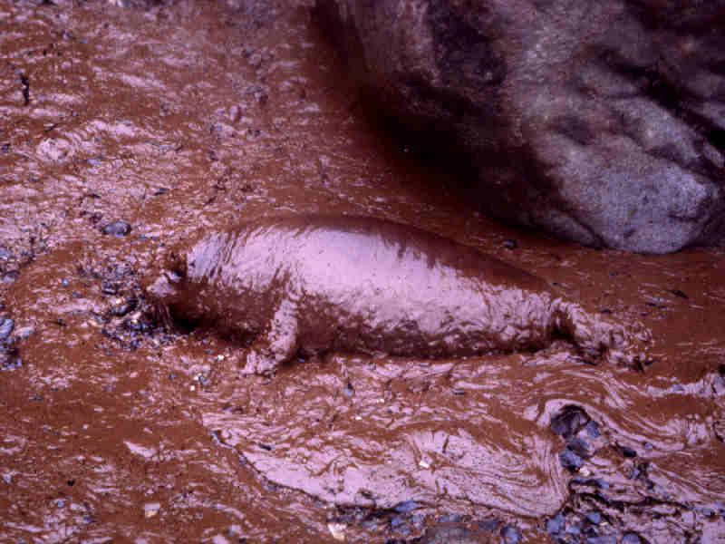

Slide 9
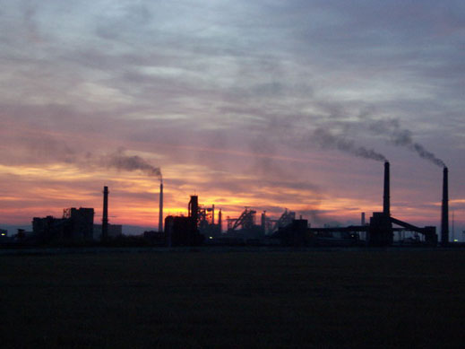
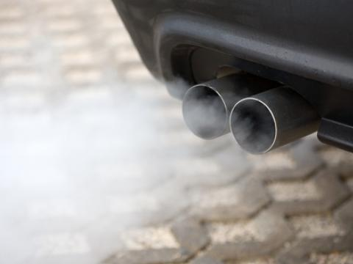
Air pollution
The main air pollutants are thermal power plants and the emissions emitted by cars. One of the substances they release is sulfur dioxide, which can cause acid rain to fall. China, Russia, USA and Japan are the leaders in air pollution.

Slide 10

Ecological hotspots in our country
The accumulation of significant amounts of solid, liquid and gaseous waste in a number of settlements turns them into so-called hotspots. In these areas, high concentrations of lead in the body of children, acute chronic and respiratory diseases of children and adults, delayed growth of children, etc. have been registered.

Slide 11
Causes of environmental pollution
Predominant share of heavy industry sectors, which are the biggest polluters of the environment.
Predominant industries have a high material intensity of the manufactured products, which is related to the use of large amounts of waste.
Concentration of many industrial enterprises in a given area, releasing large amounts of waste.
Low technological level of industrial production, use of outdated technologies.
The quality of processed raw materials and materials.
The presence of a small number of treatment facilities with low efficiency.Last but not least is the insufficient ecological culture and the public's concern for environmental protection.

Slide 12
How agriculture pollutes the environment?
In agriculture, the use of various types of pesticides and fertilizers has a detrimental effect - the soil is saturated with heavy metals, chemicals, nitrates, phosphates and other harmful waste. Decomposition of these pesticides in nature occurs very slowly, they accumulate in plants and spread throughout the entire biological cycle - soil - plant - human.

Slide 13
Transport and natural environment
Burnt car gases contain lead, nitrogen oxides and carbon dioxide, which are also the main air pollutants. Around the country's main highways, the lands are heavily polluted with toxic substances, many times exceeding the maximum permissible concentration.

Slide 14
When a critical environmental situation occurs?
As a result of the lowered environmental requirements for producers from various industrial branches, a critical environmental situation has been created in the country. The pursuit of quick profits led to the organization of new industries with harmful waste. Due to financial difficulties in the country, funds are not allocated for new treatment facilities, existing treatment plants are not modernized, new technologies are not implemented in production.

Slide 15

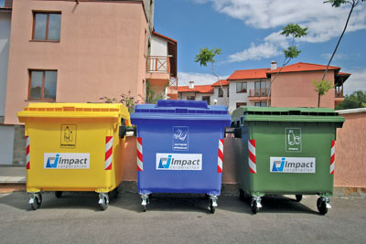
Some measures that have been taken to protect nature are separate collection, but this is only a small step forward and not enough, as the pace at which we are polluting the environment is becoming too fast.

Slide 16
